Slide 1


TEACHING WITH PRIMARY SOURCES
The Texas State Historical Association Presents
A Teacher Development Workshop
RESEARCH ANALYSIS ENGAGEMENT

Slide 2

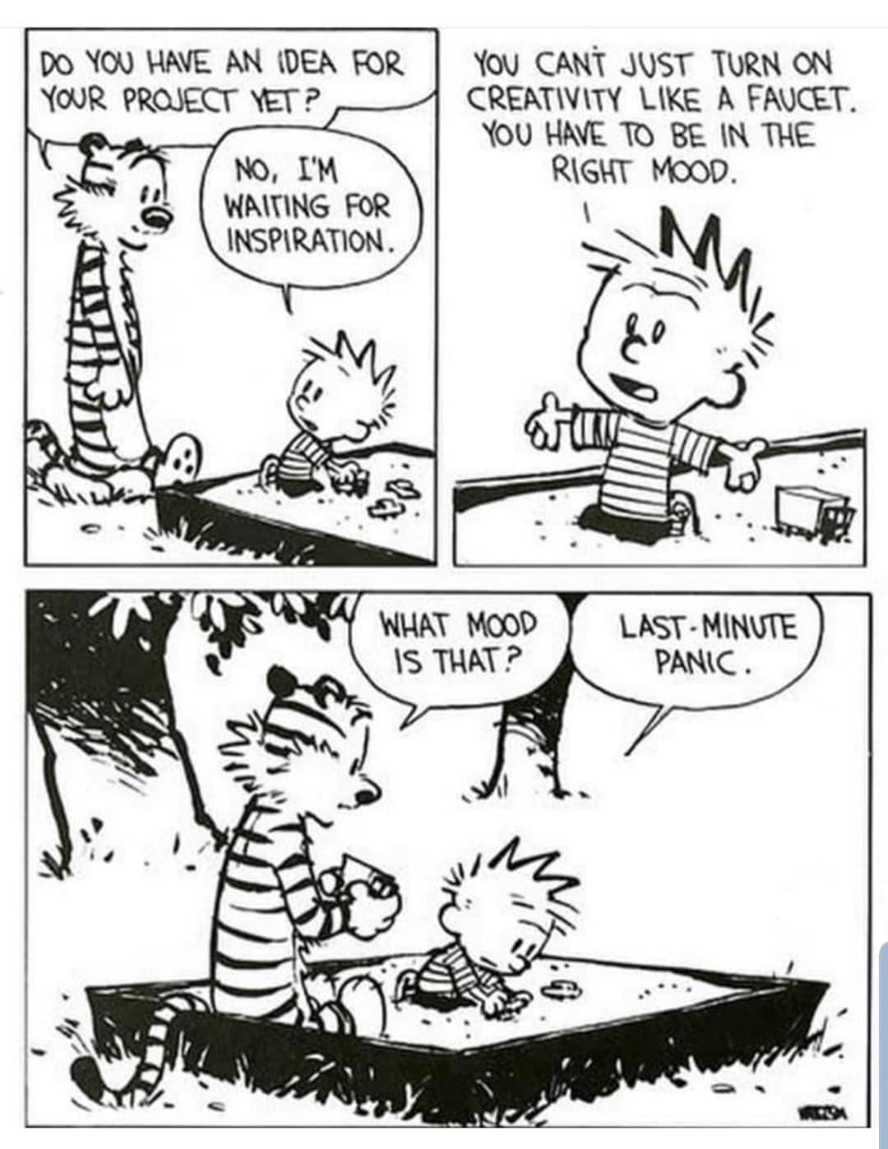

Slide 3
TSHA Research Resources
Texas Almanac
  Teacher’s Guide
This Day in Texas History
Handbook of Texas Online

Slide 4

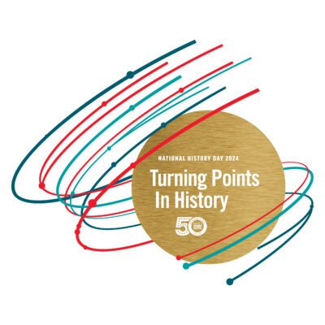
What Am I Looking For? Research Theme / Writing Prompt

Slide 5
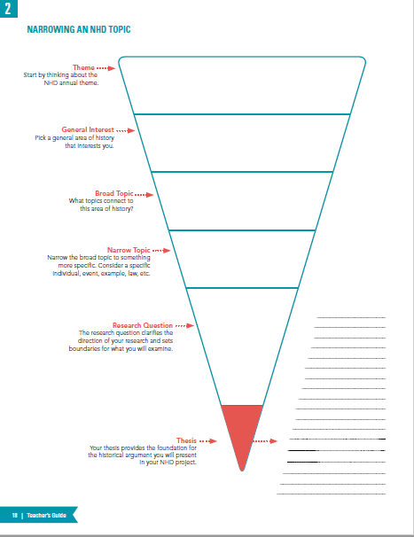
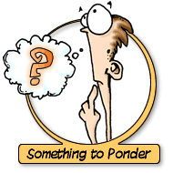
Narrowing Topic

Slide 6
HISTORICAL ARGUMENT
(Thesis Statement)
Creating a well-written historical argument is critical to a successful research project. A thesis statement is a central thought that holds the project together. It should be written after doing preliminary research and then revised as the process continues.
A well-written thesis statement will:
  address the topic
  relate to the theme
  explain the impact of the topic
Thesis = Topic + Theme + Impact.

Slide 7

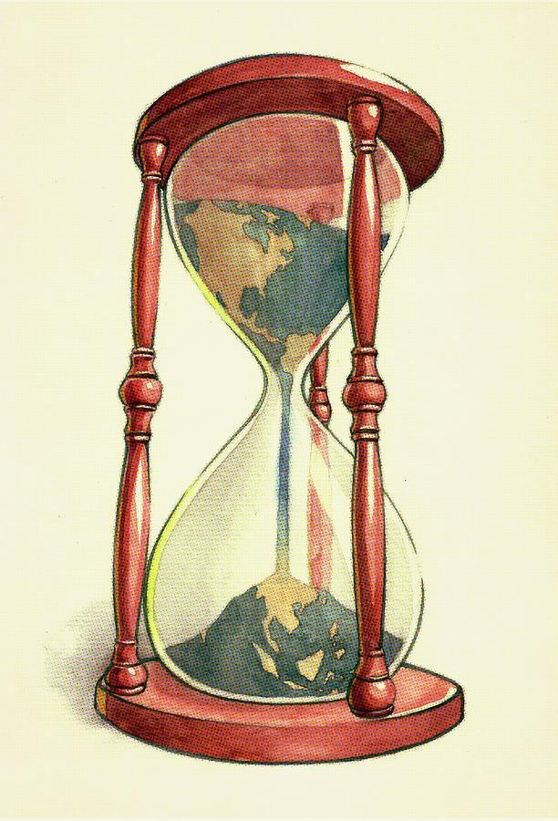

Time and place of topic
Someone who was there
What are they good for?
After event happened
Not by an eyewitness nor participant
What are they good for?

Slide 8

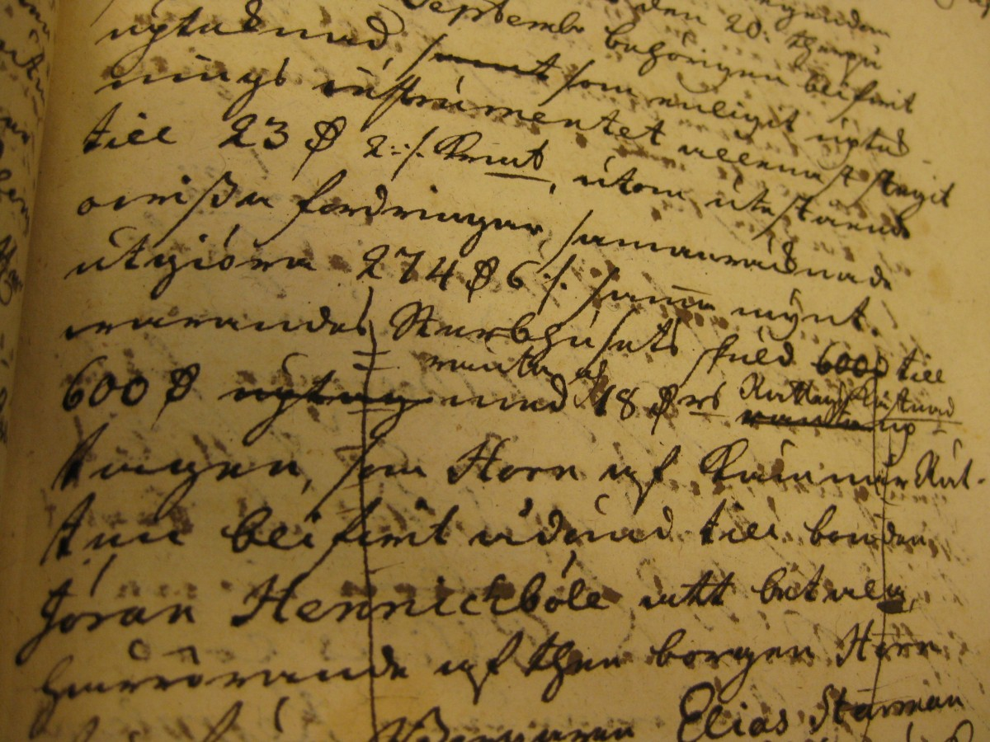
Examples
Primary Sources:
  Historic objects (artifacts)
  Oral Interviews of witness
  Manuscript Collections
  Newspapers (from time period)
  Letters and Diaries
  Government Records
  Music
  Film/Video clips
Secondary Sources:
  Biographies
  Textbooks
  Books about subject
  Newspaper articles about topic
  Documentaries
  Interviews with experts
  Encyclopedias
  Film/Video clips

Slide 9
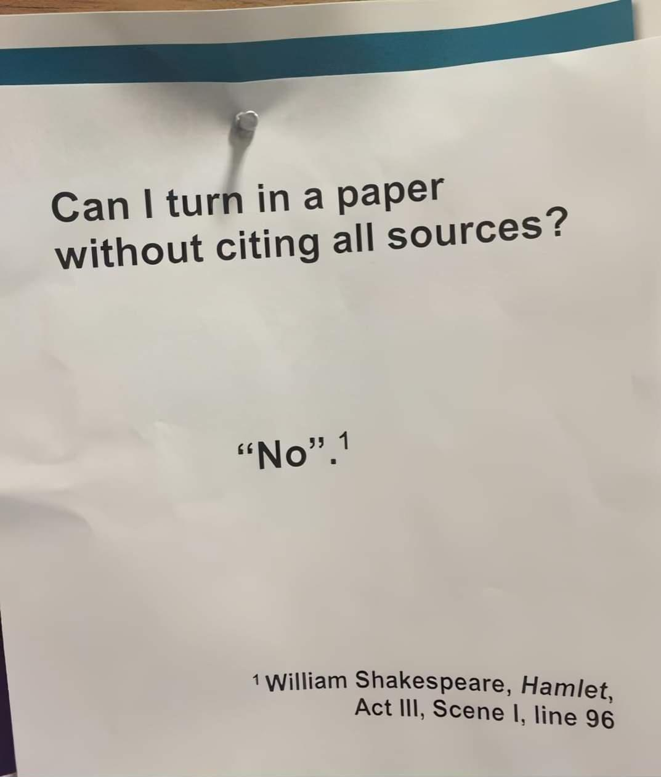
Common Mistakes: Primary Sources
Primary Source Does Not Equal Most Important Source
Original vs. Copy of Source - Does Not Matter
Primary Source Can Be After Event - Author Matters
Interview Does Not Equal Primary Source
Do Not Rely Solely On Photos from Event
Quotes - Short Quotes Are Not Primary Sources
Source: Minnesota History Day 2021 Student Research Workbook

Slide 10
Researching….Where to start?
On Texashistoryday.com
  For Teachers-- Guide to Student Research and Historical Argumentation
  For Students-- Finding, Analyzing, and Constructing History: A Research Guide for Students
MNS Student Research Workbook

Slide 11

Strategy for Analyzing Photographs
When students analyze photographs we want them to:
OBSERVE – List what they notice. Focus on details
REFLECT- Make inferences about the source. Why was it created? Who is the intended audience?
QUESTION- Ask questions about the photograph and consider where they might find answers.
For Younger Students
See
Think
Wonder

Slide 12
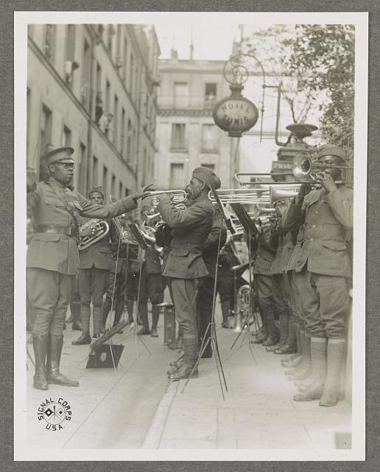
Library of Congress (2016651602)

Slide 13
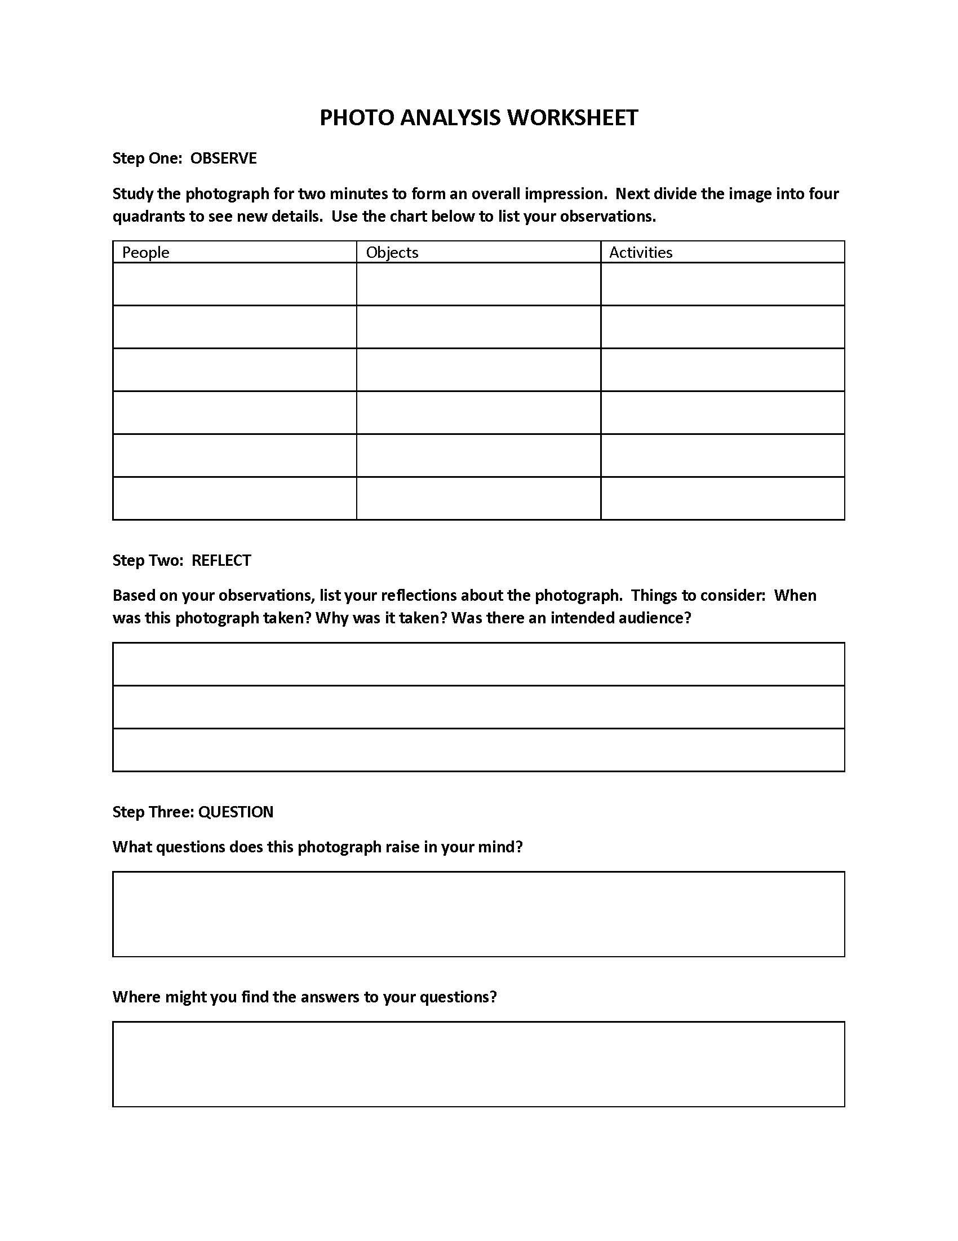
Source Analysis Tips and Tricks
Photo Primary Source Analysis
Good for:
Young Students
ESL Students

Slide 14

Strategy for Analyzing Documents
When students analyze documents we want them to:
Comprehend the document
Place the event in the proper historical context
Identify any bias reflected in the document
Recognize the author’s point of view
These things can be accomplishing using the HIPPO strategy.

Slide 15
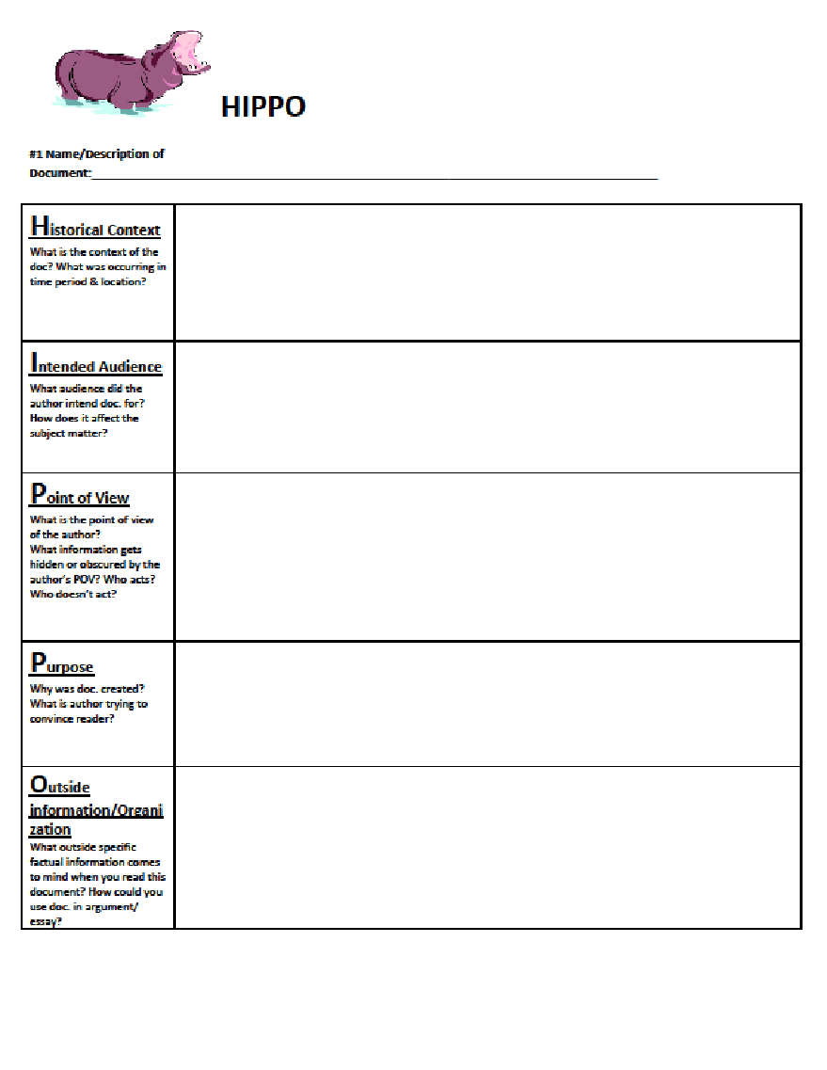
Source Analysis Tips and Tricks
HIPPO

Slide 16

The Library of Congress--Teaching with Primary Sources
Where to Start? Loc.gov/teachers
What the Library offers Teachers:
Getting Started with Primary Sources
  Teacher’s Guides and Analysis Tools
    Guides to guide students using various primary sources
    Primary Source Analysis Tool
  Finding Primary Sources
    Classroom Sets
  Strategies to using Primary Sources and Distance Learning

Slide 17
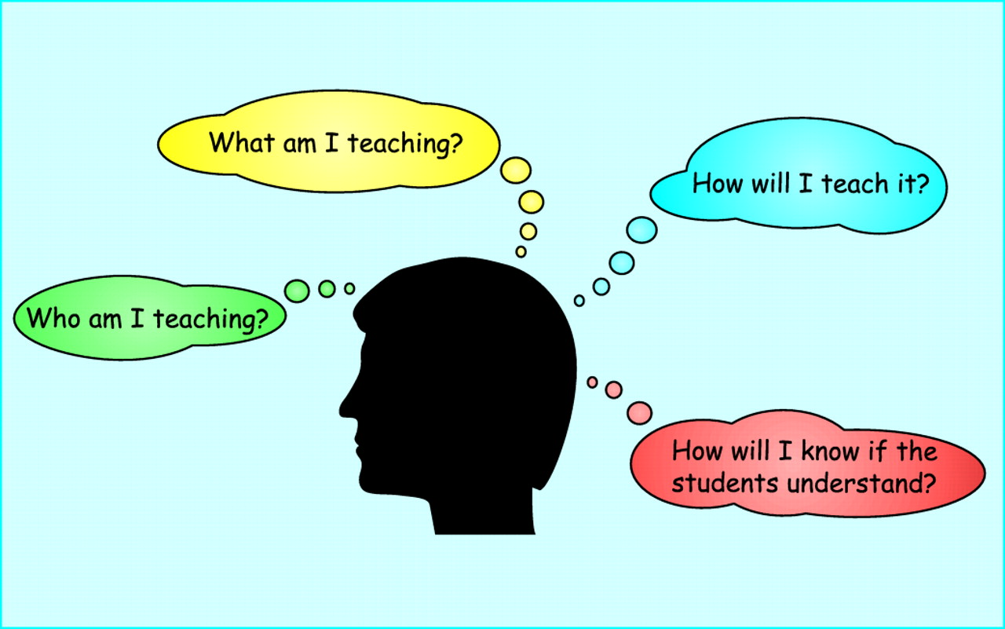
The Library of Congress--Teaching with Primary Sources
Where to Start? Loc.gov/teachers
What the Library offers Teachers:
Classroom Materials
  Primary Source Sets
  Lesson Plans
  Presentations
Professional Development
Teachers Network

Slide 18
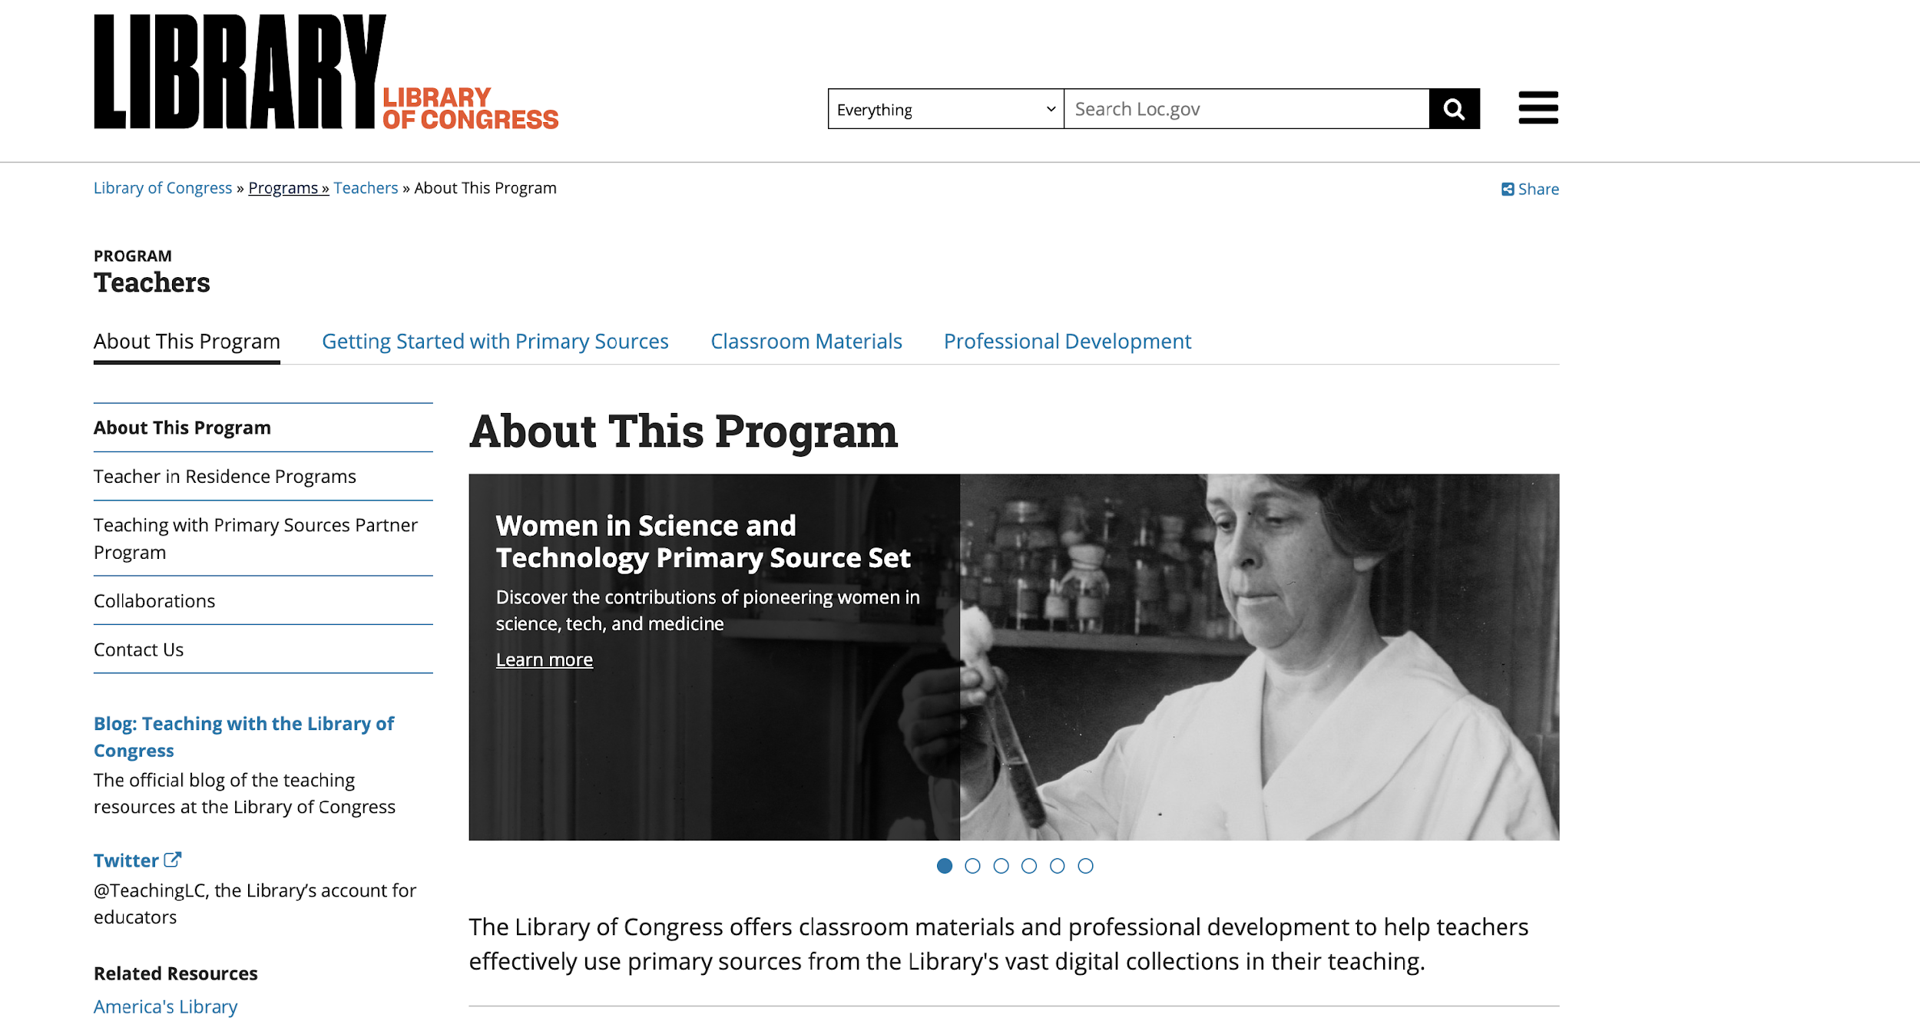
The Library of Congress--Teaching with Primary Sources

Slide 19

The Library of Congress–Researching Tips
Not every source is primary some are secondary sources
Strongest Time Period 🡪 1870s-1920s
Post 1945 🡪 Not strong since still under copyright
For photographs 🡪 Not strong past 1930s
Have a plan in place

Slide 20

The Library of Congress–Researching Tips (cont’d)
Keywords are important
Write down keywords to use
Write down dates to search
Spelling Matters!

Slide 21
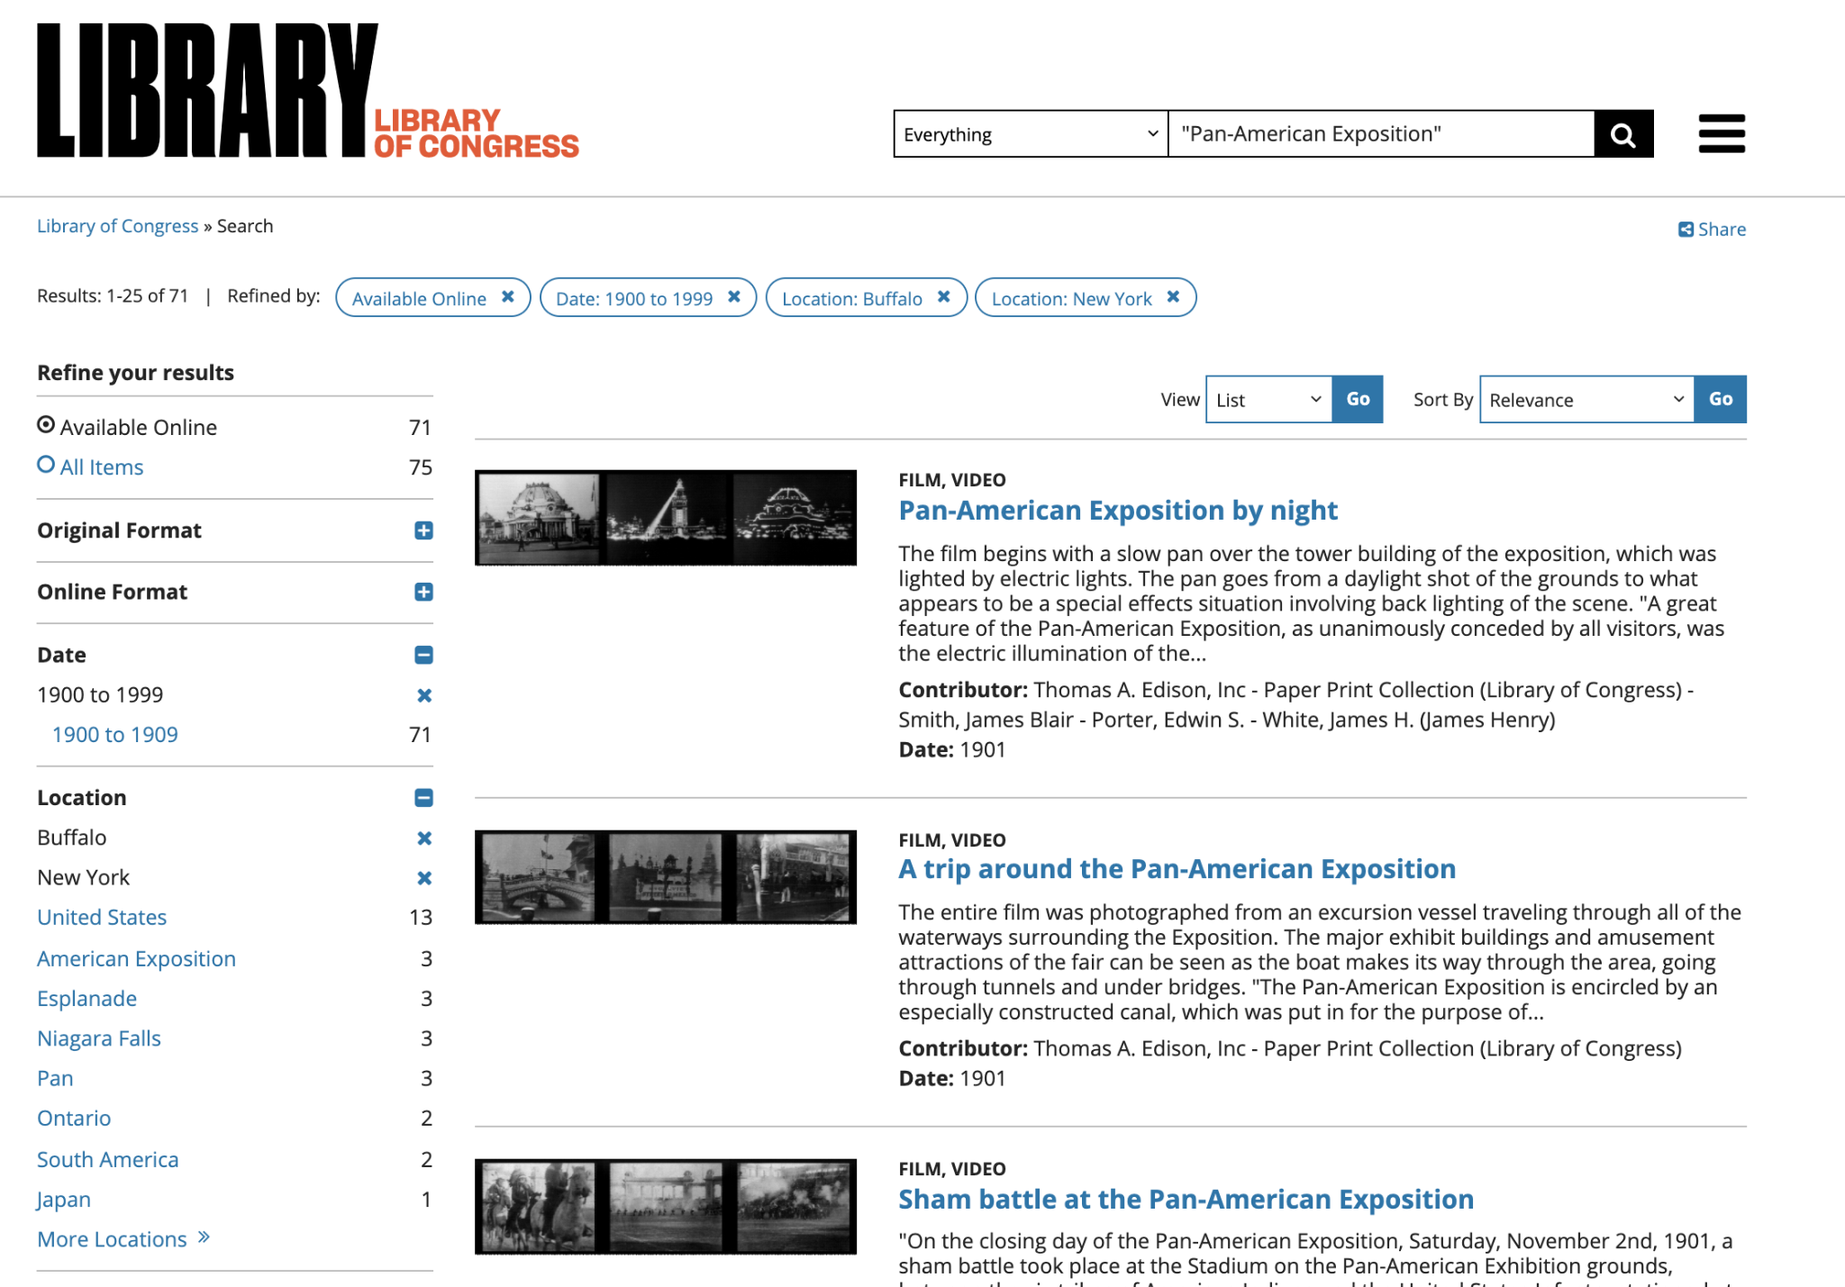
The Library of Congress–Researching Tips (cont’d)
A sort by relevance
A sort by date or title
Use the filter (Refined by:) to narrow search
  Select “Available Online”
What are “collections”?
Collections are organized by different archivists

Slide 22

The Library of Congress–Researching Tips (cont’d)
Boolean Search 🡪 type of search allowing users to combine keywords with operators and modifiers. These are tools that will limit or expand your search.
AND (+): requires that all search terms be present, which narrows the search.
  Example:
"Pan-American Exposition" AND electricity
or
"Pan-American Exposition" + electricity
NOT(-): excludes a term from the results, which also narrows the search.
  Example:
"Pan-American Exposition" NOT Dallas
Or
"Pan-American Exposition" – Dallas
OR (|): search for either of two terms, which widens the search.
  Example:
electric OR electricity

