Slide 1
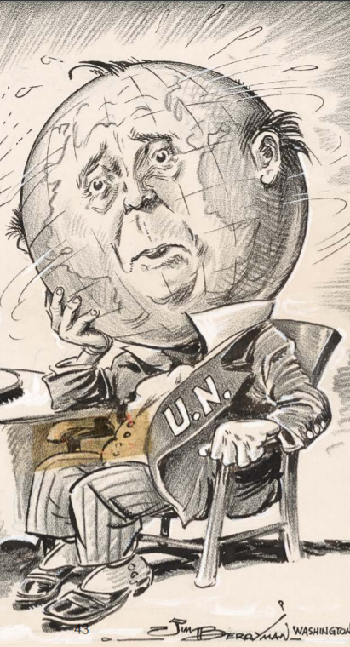
Images from the Age of Anxiety:
Teaching about the Cold War
1946 — 1963
with Political Cartoons
From the
Center for Legislative Archives
&
the National Archives

Slide 2
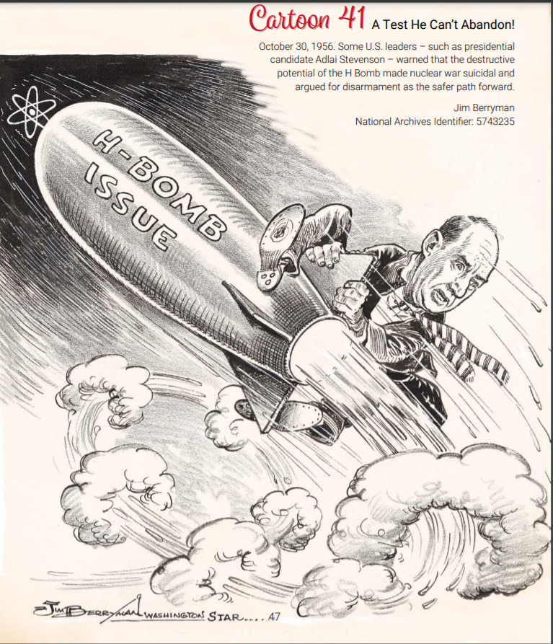
This presentation will feature political cartoons created by artists
Clifford and Jim Berryman
for the Evening Star in Washington, DC from 1945 – 1963.
The images depict major issues of the Cold War and provide student-friendly educational resources:
for teaching history
for building critical thinking skills

Slide 3
TEKS
8) History. The student understands the impact of
significant national and international decisions and conflicts in the Cold War on the United States.
The student is expected to:
describe U.S. responses to Soviet aggression after World War II, including the Truman Doctrine, the Marshall Plan, the North Atlantic Treaty Organization, the Berlin airlift, and John F. Kennedy's role in the Cuban Missile Crisis;
describe how Cold War tensions were intensified by the arms race, the space race, McCarthyism, and the House Un-American Activities Committee (HUAC), the findings of which were confirmed by the Venona Papers;
explain reasons and outcomes for U.S. involvement in the Korean War and its relationship to the containment policy;
explain reasons and outcomes for U.S. involvement in foreign countries and their relationship to the Domino Theory, including the Vietnam War;

Slide 4
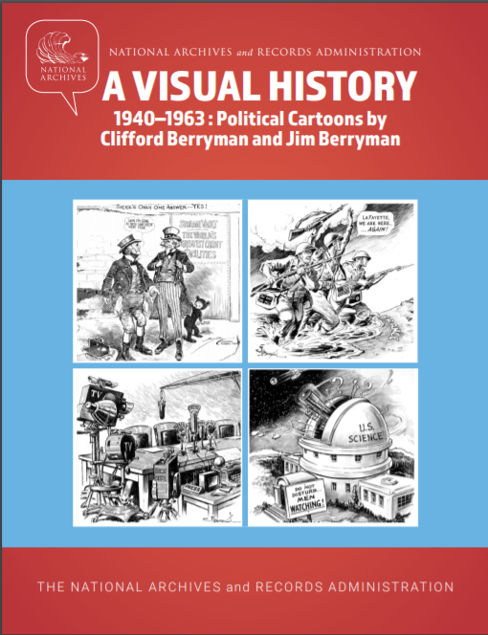
The cartoons, along with details about their historical context, are
available in a free eBook
from the Center for Legislative Archives:
https://www.archives.gov/legislative/resources/ebooks

Slide 5
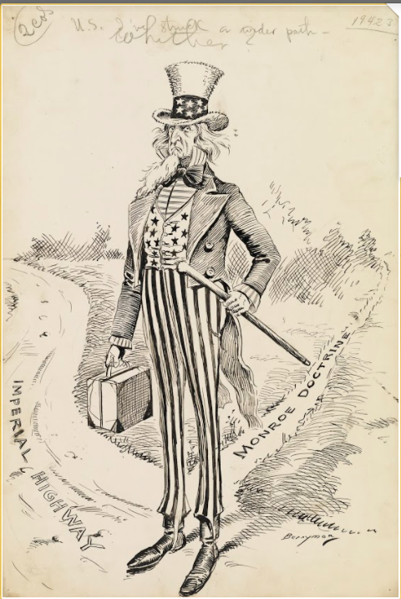
The Cold War was a chapter in America’s relationship to the world.
19th Century U.S. foreign policy:
guided by the Monroe Doctrine
focused on the Western Hemisphere
anti-colonial in spirit
1898 War with Spain — cross-roads:
the path of the Monroe Doctrine?
Imperialism?
America debates its role in the world 1918 - 1941:
at times neutral
at times a global leader
NAID: 6010279

Slide 6
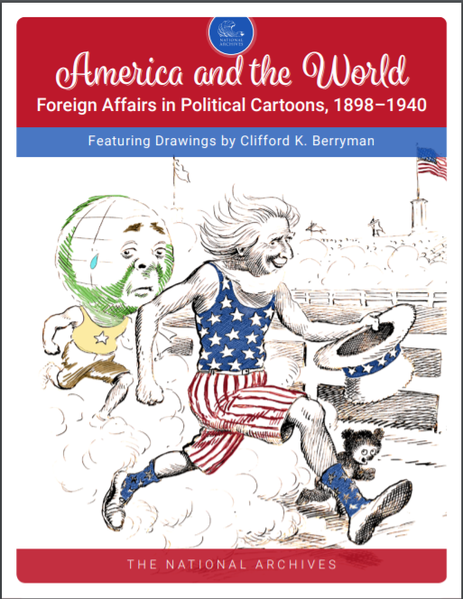
Political cartoons for teaching
U.S. foreign policy 1898 – 1940:
available in a free eBook
from the Center for Legislative Archives:
https://www.archives.gov/legislative/resources/ebooks

Slide 7
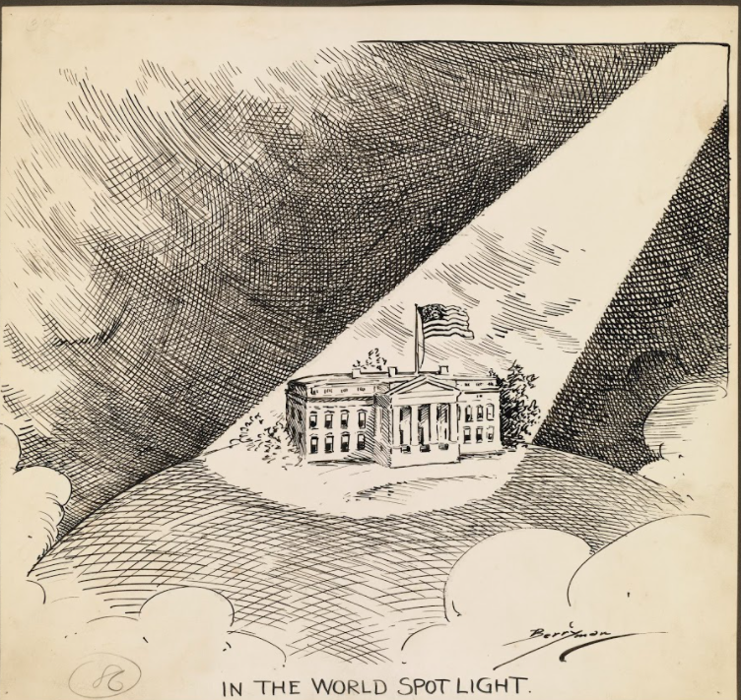
President Woodrow Wilson’s
World War I leadership
14 Point peace plan
call for a League of Nations
Direct post-war attention on the U.S.
1918: U.S. at the pinnacle of its global influence, to date.
“In the World Spotlight” The Evening Star October 8, 1918 NAID 6011512
Notes:
“In the World Spotlight” The Evening Star October 8, 1918 NAID 6011512 “In the World Spotlight” appeared on the front page of The Evening Star as President Woodrow Wilson was considering a request for peace received from the new German Chancellor, Prince Maximilian of Baden. The cartoon was published alongside an article reporting Wilson’s insistence that Germany remove its troops from invaded countries as a precondition to peace. Berryman’s cartoon illustrates Wilson’s and America’s central role in preparing for the peace negotiations that would end World War I. Wilson seized the international spotlight when he outlined his “Fourteen Points” for peace in an address to Congress on January 8, 1918.

Slide 8
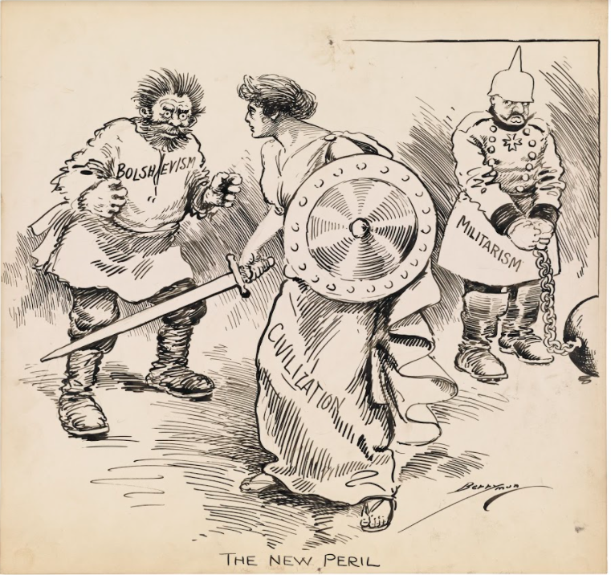
The end of Word War I was a moment for charting new courses in international relations.
The militarism that had triggered war had been shackled.
But, new danger was unleashed by the Russian Revolution and the rise of Bolshevism.
What role would the U.S. play in shaping this era?
“The New Peril” The Evening Star January 10, 1919 NAID 6011546
NAID: 6011546
Notes:
“The New Peril” The Evening Star January 10, 1919 NAID 6011546 A classical Greco-Roman woman representing civilization stands cautiously between a wild-haired, frightening man representing bolshevism and a handcuffed and chained German soldier representing militarism. The cartoon suggests that although civilization had defeated German militarism, it now faces a new threat. An article published in The Evening Star on the same day suggested that the Allies saw it as America’s responsibility to “police” Europe. Berryman’s cartoon reflects the European fear that bolshevism would solidify its control over Russia and fill the power vacuum left by the war in Germany and Eastern Europe. Published at a time when hunger and political instability fueled widespread revolutionary movements, this cartoon reflects an uneasy realization that the war fought by America to make the world safe for democracy had not ended, but rather had expanded into a wider responsibility of preserving civilized order.

Slide 9
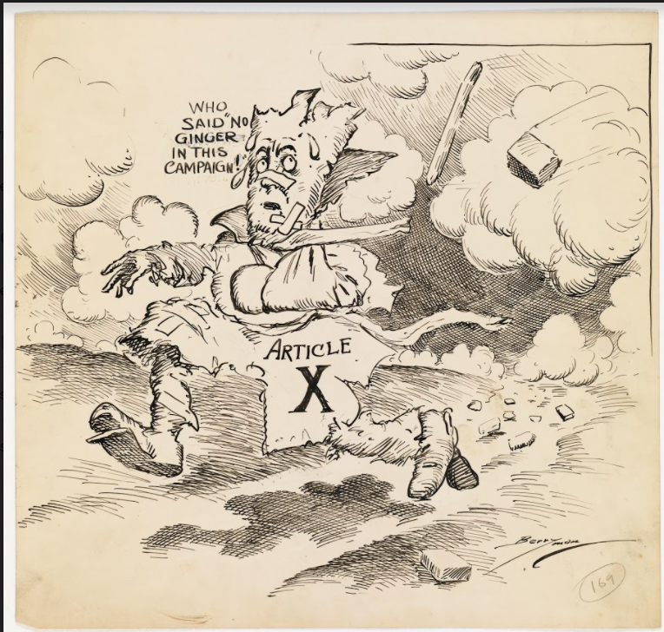
This 1920 cartoon shows Article X of the Treaty of Versailles on the run.
The Senate had rejected the treaty in August 1919.
Critics denounced U.S. participation in the League of Nations – proposed in Article X.
Voters followed the lead of Wilson’s critics, rejecting internationalism throughout the next decade.
“Article X” The Evening Star October 19, 1920 NAID 6011640
Notes:
“Article X” The Evening Star October 19, 1920 NAID 6011640 The Treaty of Versailles and U.S. membership in the League of Nations were central issues in the 1920 Presidential campaign. Article X of the Covenant of the League of Nations, which required members to assist any other member nation in the event of an invasion or attack, was a lightning rod for opposition in America. President Woodrow Wilson had submitted the Treaty of Versailles for Senate ratification in August 1919, but it was rejected due to opposition led by Henry Cabot Lodge and other Senators opposed to foreign entanglements on Wilson’s terms. In particular, concerns over Article X failed to produce a Senate compromise needed for treaty approval. After the Treaty’s rejection, public opinion divided over U.S. participation in international peacekeeping treaties. In the 1920 Presidential campaign, Democratic candidate James Cox supported the spirit of Article X in American foreign policy, while Republican candidate Warren G. Harding opposed the policy. Berryman’s cartoon captures the bitterness of the debate and the campaign. Rejected by the Senate and unpopular with many voters, Article X was an outcast on the run. “No ginger” was a sporting term for a team that showed no pep. It is used here in an ironic sense, illustrating the strong feelings about Article X expressed by its opponents during the campaign.

Slide 10
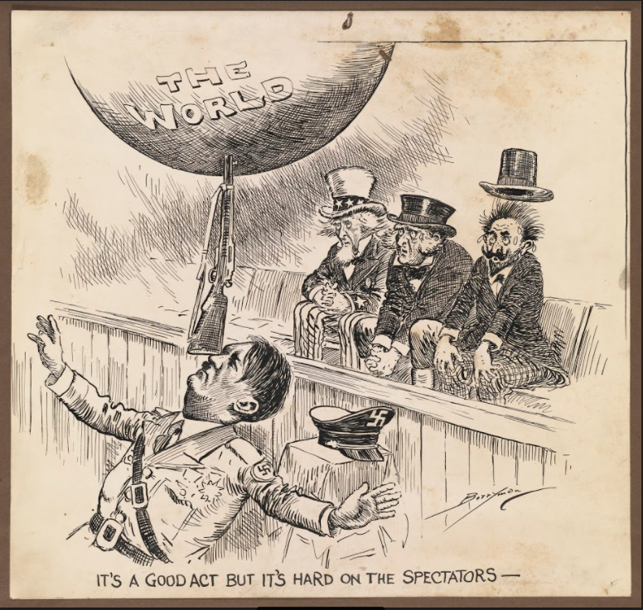
From 1920 – 1941, U.S. foreign policy was based in neutrality and relied on international agreements limiting arms and renouncing war to keep the peace.
The idealistic hopes of the 1920s and 30s were dashed when Hitler, and other militant authoritarians, emerged in the late 1930s, and threatened a new world war.
NAID: 6012197
Notes:
“It’s a Good Act, but It’s Hard on the Spectators” The Evening Star August 20, 1939 NAID 6012197 By late summer, 1939 Hitler’s army was on the march. This cartoon was published as 100,000 German troops massed along the Polish border ready to invade. Given the recent history of war, these events raised alarm in France, the United Kingdom, and the United States, represented by the figures in this image. Previously, Hitler had defied the Treaty of Versailles by moving troops into the Rhineland. Two years later, Germany had forcibly taken over Austria. The severity of response shown by the three figures in the cartoon reflects their nearness to Germany—France is the most frightened. Two days after this cartoon was published the Soviet Union and Germany announced a non-aggression pact, destroying hopes of a British, French, and Soviet alliance to restrain German expansion and clearing the way for the Nazi invasion of Poland. Berryman shares Uncle Sam’s worry that American policies of isolation and neutrality would not insulate the country from the Nazi threat.

Slide 11
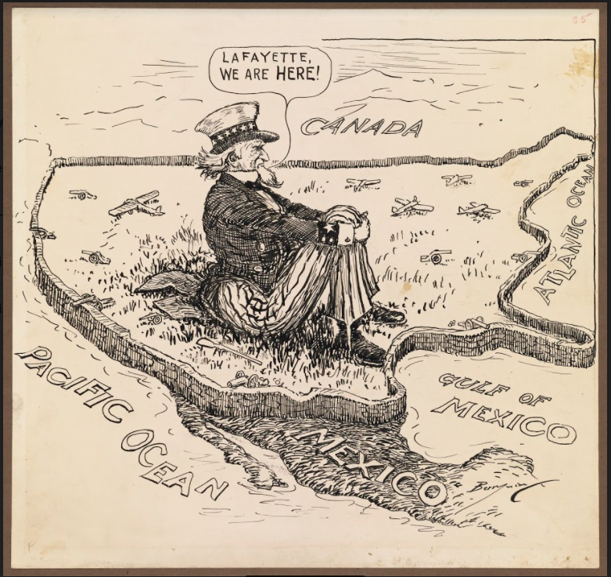
As Italy invaded Ethiopia (1935)
Japan invaded China (1937)
Germany and Russia divided Poland (1939)
And France fell to a German invasion (1940)
America clung to neutrality
NAID: 6012212

Slide 12
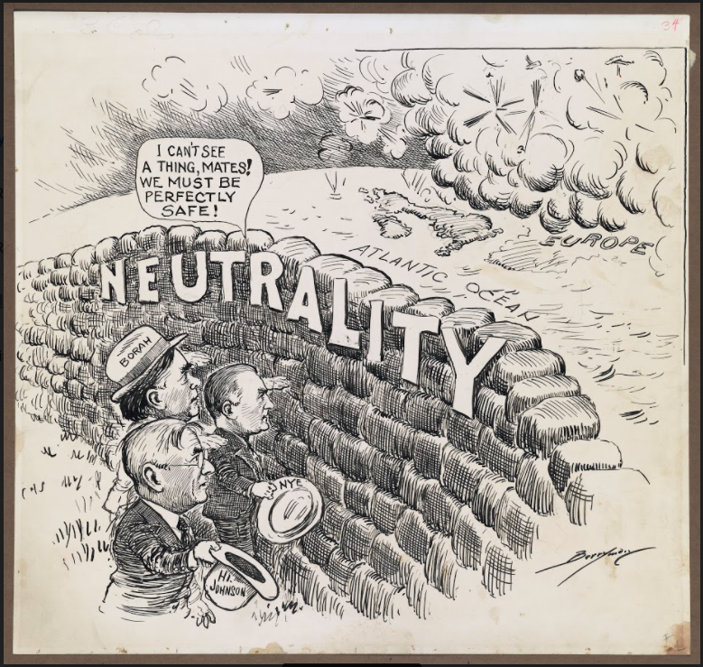
Until the attack on Pearl Harbor,
America denied the international peril it faced.
Congress was dominated by isolationists who prized neutrality in the face of danger
And resisted President Franklin D. Roosevelt’s calls for preparedness.
NAID 6012202
Notes:
Untitled The Evening Star September 7, 1939 NAID 6012202 This cartoon shows three prominent isolationist senators staring blindly at a wall labeled “neutrality,” while embattled Europe is shown in the distance, engulfed in a cloud of smoke. The figures in the cartoon are William Borah of Idaho, Gerald Nye of North Dakota, and Hiram Johnson of California. They were all Progressive Republican Senators who shared a long history of leading efforts to keep the United States out of international alliances and wars. Borah had opposed the Treaty of Versailles and was against America’s joining the League of Nations. Nye had chaired an investigative committee harshly critical of U.S. entry into the World War I. Johnson sponsored the Neutrality Acts in Congress and opposed President Franklin D. Roosevelt’s proposal to sell planes and arms to France. World War I was fresh in the public memory, and isolationists still resented America’s involvement. In this cartoon, Berryman mocks the short-sightedness of isolationism.

Slide 13
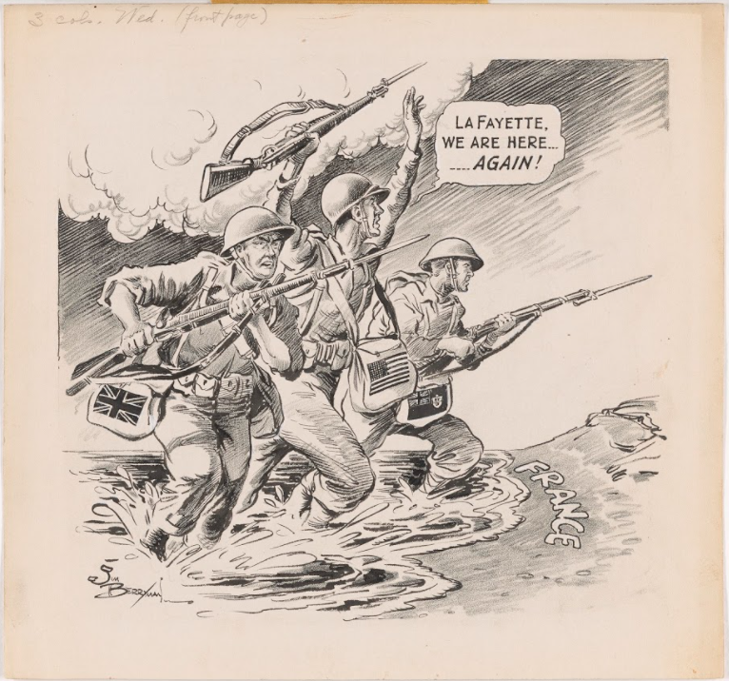
Spurred to action by the attack on Pearl Harbor.
America followed President Roosevelt’s lead and made unprecedented sacrifices in fighting a global war on the Axis powers.
Four years of total war and the use of horrific weapons of mass destruction finally ended the danger.
Victory was achieved in 1945.
NAID: 5743133
Notes:
Lafayette We Are Here Again June 7, 1944 Jim Berryman NAID: 5743133 On June 6, 1944, known as D-Day, the Allied forces landed on the beaches of northern France, launching the Battle of Normandy, which would ultimately liberate Western Europe from Nazi Germany. This cartoon appeared a day later. Clifford Berryman had used the phrase “Lafayette, we are here” in an earlier cartoon, echoing a famous quotation. Commonly attributed to General John J. Pershing, the commander of U.S. forces in Europe in World War I, the phrase was actually first spoken by Pershing’s aide, Colonel Charles E. Stanton, in a July 4, 1917, speech at the tomb of the Marquis de Lafayette in Paris. A French nobleman and military general, Lafayette had fought on the American side during the Revolutionary War. Stanton’s 1917 speech honored Lafayette and underscored America’s commitment to helping France during World War I. Here, Berryman refers to that long history, as the U.S. once more rushes to help France, its oldest ally, on D-Day.

Slide 14
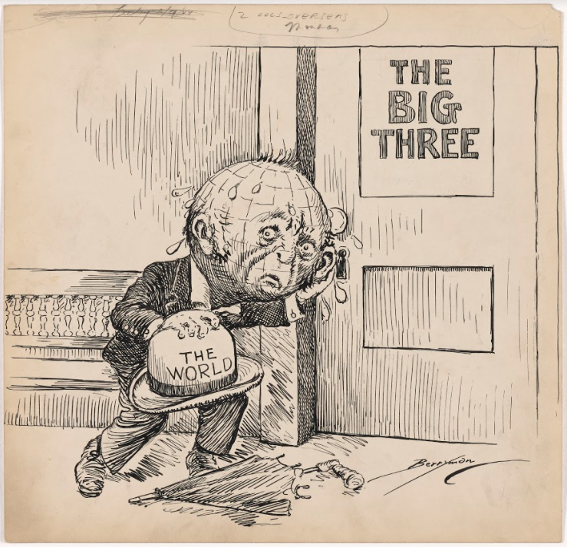
Europe’s future was decided at the Yalta Meetings held in the last months of the war:
“The Big Three”
President Franklin D. Roosevelt
Prime Minister Winston Churchill
Soviet Premier Joseph Stalin
demonstrated unity as they discussed the reorganization of Europe
“The World Waits at Yalta” The Evening Star February 9, 1945 Clifford K. Berryman NAID: 6012295
Notes:
The World Waits at Yalta February 9, 1945 Clifford K. Berryman NAID: 6012295 In February, 1945, as the war in Europe neared its end, the leaders of the major Allied Powers (the U.S., Great Britain, and the Soviet Union) held a series of meetings in the Soviet city of Yalta. “The Big Three” (President Franklin D. Roosevelt, Prime Minister Winston Churchill, and Soviet Premier Joseph Stalin) demonstrated their unity and discussed the reorganization of Europe after the war. Each leader had particular strategic goals. Stalin, for example, was determined to retain influence in Eastern Europe. One important outcome of the Yalta Conference was that Stalin promised to declare war on Japan once Germany surrendered. In addition, the Allies agreed to create an international peacekeeping organization, an intention realized after the war with the founding of the United Nations. In this cartoon, Berryman depicts a war-weary world anxiously listening in on the Yalta talks

Slide 15
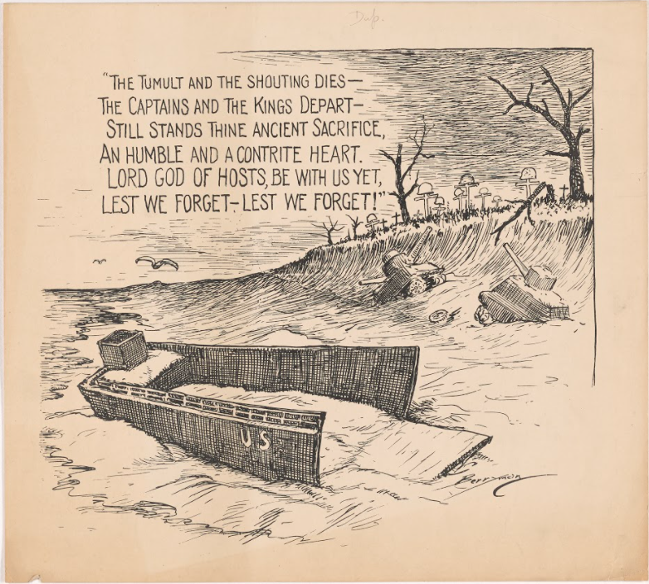
Soon after Yalta,
On the anniversary of D-Day, this cartoon asked -
what America owed the fallen?
Could America retreat into isolation as it had after World War I?
Was the U.S. obliged to shape the future?
“Lest We Forget” The Evening Star June 6, 1945 Clifford K. Berryman NAID: 6012308
Notes:
Lest We Forget June 6, 1945 Clifford K. Berryman NAID: 6012308 This cartoon was published on the one-year anniversary of D-Day, the day the Allied forces landed on the beaches of Normandy, France, to begin the military campaign that would ultimately liberate Western Europe from Nazi Germany. Thousands of men died during the Battle of Normandy, which was the largest seaborne invasion in history. Berryman’s cartoon recalls the destruction and loss of life on those beaches and honors those who made the ultimate sacrifice in this pivotal battle. The words hovering in the sky are from Rudyard Kipling’s famous poem “Recessional,” which juxtaposes the temporary nature of empire with the permanence of God. About a month before this D-Day anniversary, the war in Europe officially ended when Germany surrendered on May 8, 1945.

Slide 16
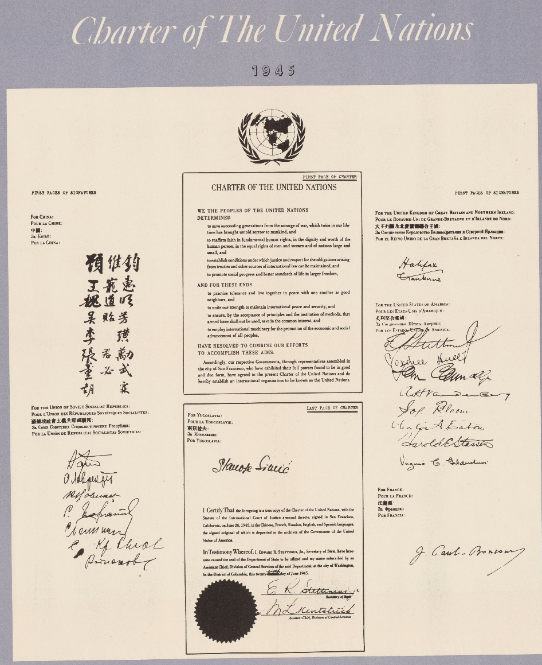
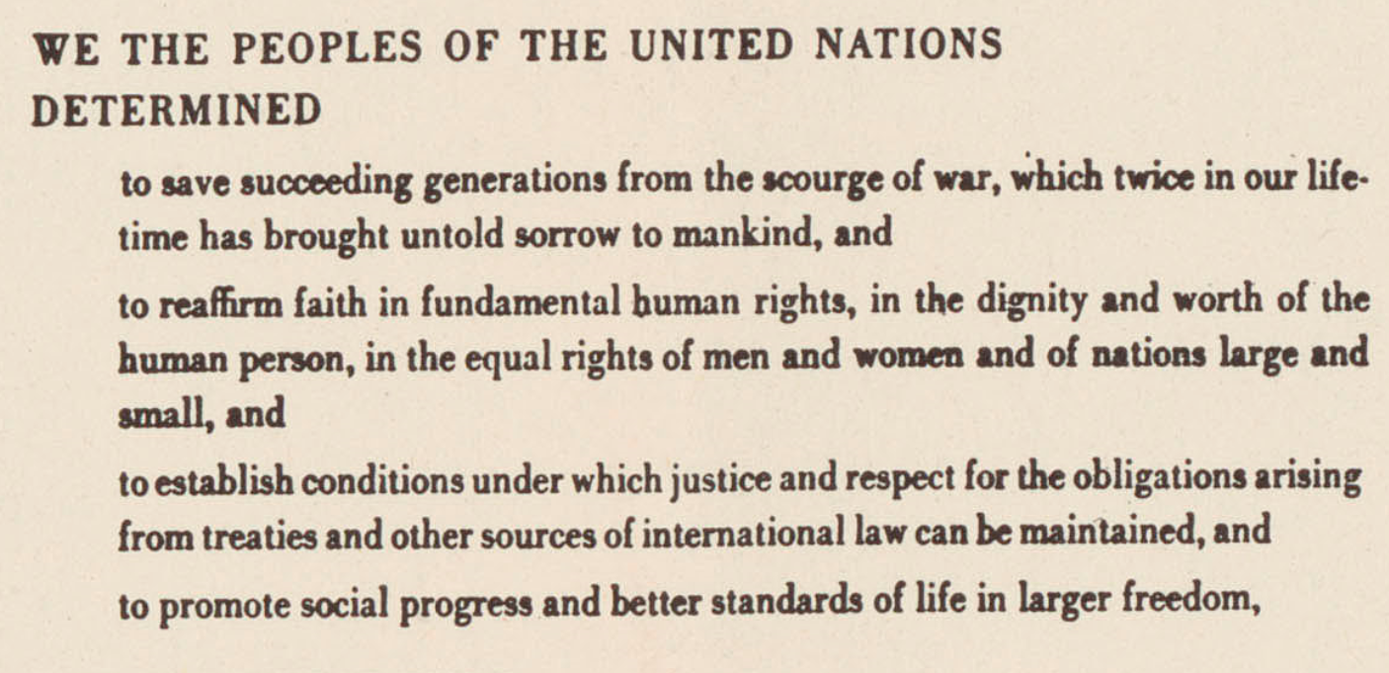
The UN Charter
The Charter of the United Nations, signed on June 26, 1945
Embodied the spirit of Wilson’s 14 Points
NAID: 514049

Slide 17
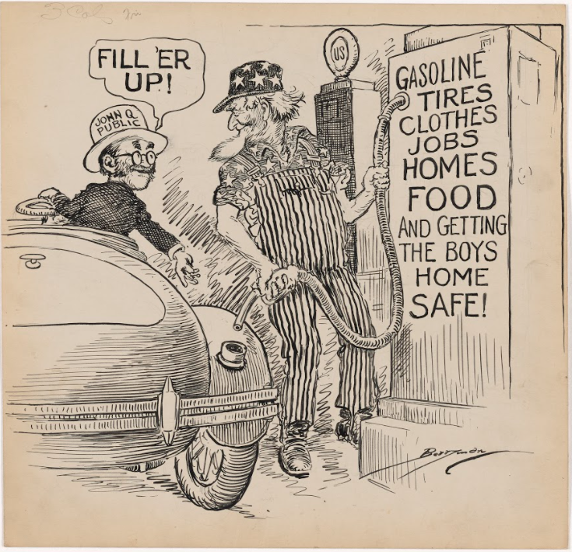
After years of sacrifice, the American public was eager to enjoy peace:
FILL ‘ER UP!
Two days after the surrender of Japan, John Q. Public asks Uncle Sam to fill his tank with all the “goods” that had been either rationed or in short supply during the war
“FILL ‘ER UP!” August 17, 1945 Clifford K. Berryman NAID: 6012312
Notes:
FILL ‘ER UP! August 17, 1945 Clifford K. Berryman NAID: 6012312 On August 15, 1945, Japan announced its surrender, bringing World War II to a close. In this cartoon, published two days later, Berryman captures the pent-up desires of the American people for consumer goods and normal life. John Q. Public (the average citizen) asks Uncle Sam to fill his tank with all the “goods” that had been either rationed or in short supply. The postwar years saw a boom in the production and consumption of clothes, cars, household appliances, and more. Returning veterans started to have families and needed homes. The G.I. Bill, a package of government benefits to help veterans transition to civilian life, included home loans, which spurred home-buying and construction. After a decade of economic depression and five years of all-out war, Americans were eager to enjoy the benefits of a consumer-focused economy. The supply of goods, the cost of living, and access to housing would become thorny political issues in the post-war era

Slide 18
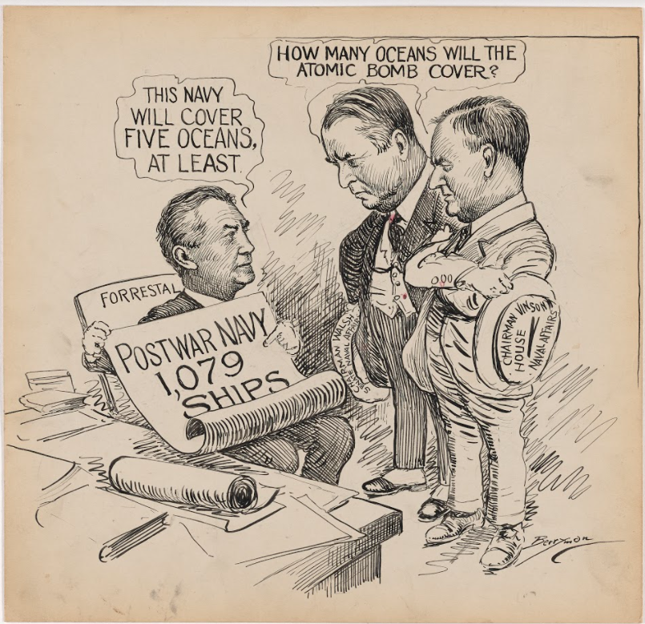
What would the U.S. military look like after the war?
Previously, the U.S. had scrapped its military forces and slashed military spending at war’s end.
In 1945, officials asked what size military the U.S. would need in a “peacetime” shaped by new international obligations and one that included atomic weapons?
“Postwar Navy” The Evening Star September 11, 1945 Clifford K. Berryman NAID: 6012314
Notes:
Postwar Navy September 11, 1945 Clifford K. Berryman NAID: 6012314 On August 6 and 9, 1945, the U.S. dropped atomic bombs on the Japanese cities of Hiroshima and Nagasaki, killing over 100,000 people. On August 15, Japan announced its surrender, ending the war. Among the tasks the U.S. faced next was scaling the military to a size and strength suitable for peacetime. But what sort of military did the U.S. need in a “peacetime” that included nuclear weapons? Military leaders, together with Congress, had to figure this out. In this cartoon, the seated figure is Secretary of the Navy James Forrestal. Standing are Senator David Walsh (chairman of the U.S. Senate’s Committee on Naval Affairs) and Representative Carl Vinson (chairman of the U.S. House of Representatives’ Committee on Naval Affairs). The day before this cartoon appeared, Walsh and Vinson had announced plans for a fleet of 1,079 ships, the number requested by the Navy. They were postponing a final decision, however, until after thorough study, recognizing that new weapons of war had changed the military landscape.

Slide 19
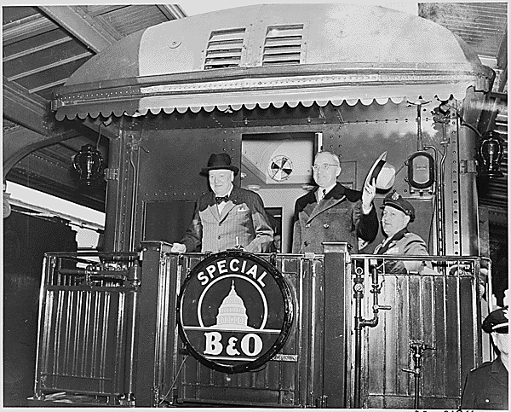
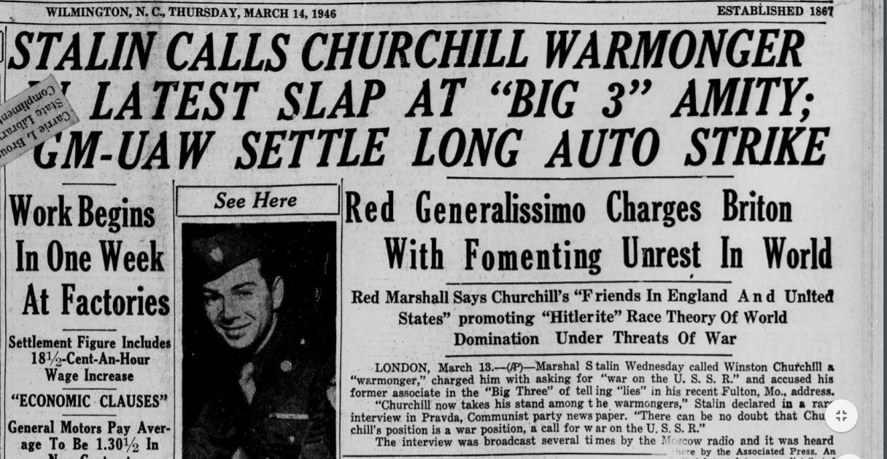
Winston Churchill’s 1946 “Iron Curtain” Speech shattered hopes for a peaceful post-war era.
“From Stettin in the Baltic to Trieste in the Adriatic, an iron curtain has descended across the Continent. Behind that line… all are subject in one form or another, not only to Soviet influence but to a very high and, in many cases, increasing measure of control from Moscow.”
NAID 199349
https://chroniclingamerica.loc.gov/data/batches/ncu_lily_ver01/data/sn78002169/00279558893/1946031401/0189.pdf

Slide 20
Conflict in Europe | Ideological Conflict
Conflict in Asia | Cold War Technology
Middle East Conflicts | Fear of Subversion
Western Hemisphere Conflict
7 Sources of Cold War Anxiety

Slide 21
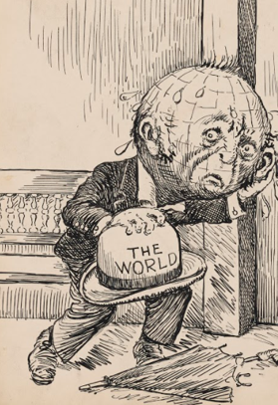
1946

Slide 22
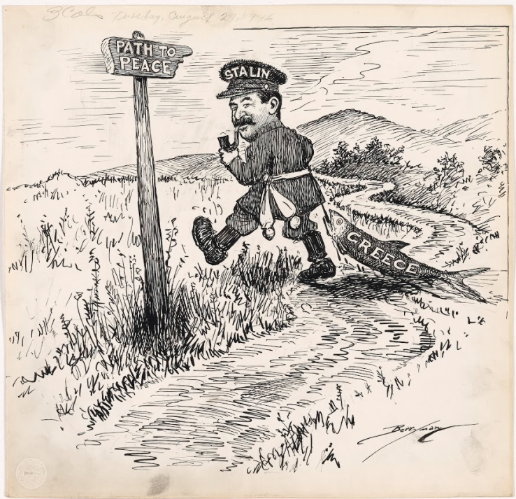
Conflict in Europe
“Path to Peace”?
1946
USSR Meddles in Greece
Communists and non-communists contend for control of Greece
USSR supports communists, exerting influence in post-war Europe
“Path to Peace,” The Evening Star August 27, 1946 Clifford K. Berryman NAID: 6012362
Notes:
Path to Peace August 27, 1946 Clifford K. Berryman NAID: 6012362 Berryman drew this cartoon when communists and non-communists were contending for control of Greece. Although the U.S. and the U.S.S.R. had worked together to defeat Nazi Germany in World War II, after the war it was difficult for the two countries to stay on a path that would lead to a peaceful, secure Europe. With their economies and political systems weakened by war, countries across Europe and Asia were vulnerable. The U.S.S.R. used this situation to expand its influence. Led by General Secretary Joseph Stalin, the U.S.S.R. first sought political control of the countries on its border in Eastern Europe. Some people thought it was reasonable for the Russians to want a buffer zone of friendly countries. Others suspected Stalin’s motives and feared the spread of communism, an ideology committed to the end of capitalism. Distrust grew once Stalin started to expand Soviet influence westward into central Europe and the Balkans and southward into the Middle East. In this cartoon, Stalin is shown veering off the path of peace with Greece as his “catch.”

Slide 23
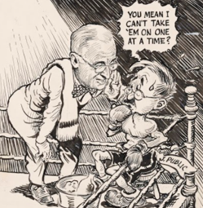
1947

Slide 24
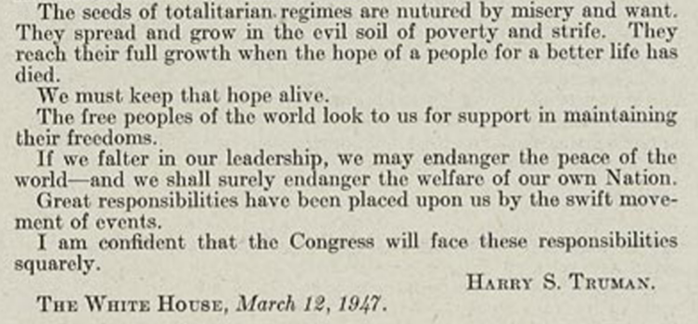
Conflict in Europe
The Truman Doctrine,
1947
The seeds of totalitarian regimes are nurtured by misery and want. They spread and grow in the evil soil of poverty and strife. They reach their full growth when the hope of a people for a better life has died. We must keep that hope alive.
The free peoples of the world look to us for support in maintaining their freedoms.
If we falter in our leadership, we may endanger the peace of the world -- and we shall surely endanger the welfare of our own nation.
NAID: 2668751

Slide 25
Conflict in Europe
One at a Time?
1947
President Truman urges America to fight communism abroad
The public fears inflation at home
“One at a Time?” The Evening Star November 19, 1947 Jim Berryman NAID: 5743141
Notes:
One at a Time? November 19, 1947 Jim Berryman NAID: 5743141 As the Soviet Union expanded its influence after World War II, American leaders grew concerned about Soviet power and the spread of communism. In a speech to Congress in March of 1947, President Harry Truman declared that America would provide political, economic, and military assistance to any democratic nation under internal or external threat. Later known as the Truman Doctrine, this statement signaled the U.S. government’s new willingness to become involved in far-flung conflicts. But Truman had to convince the American people of the urgent need to fight communism abroad at a time when many were more concerned about inflation at home. After the war, demand for goods outstripped supply, prices rose, and Americans discovered that their dollars did not go as far as they once had. In this cartoon, President Truman urges “J. Public” (the American people) to tackle both problems at once

Slide 26
Fear of Subversion
Communists in Hollywood
1947
The House Un-American Activities Committee issued subpoenas for leading figures in Hollywood
Are communists using movies to spread propaganda?
NAID: 24495625

Slide 27
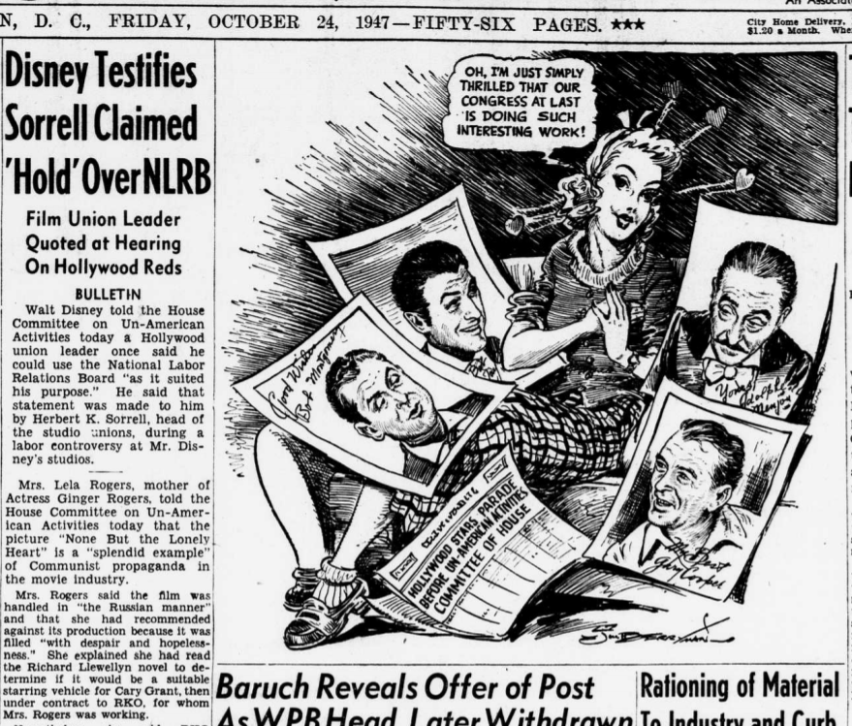
Fear of Subversion
Rogers testifies that “None But the Lonely is a splendid example of Communist propaganda in the movie industry.”
Berryman as an artist: Bias? Point of View? Reflecting historic social attitudes?
The Evening Star, 10/24/47 Source: LOC.gov

Slide 28
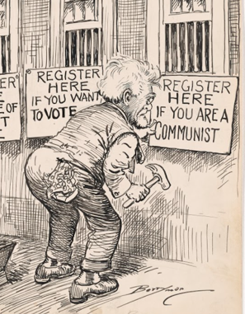
1948

Slide 29
Fear of Subversion
Reining in Communists
1948
Anxiety about communism abroad and at home filled the post-war era
The Mundt-Nixon Bill required communists to register with the government
The bill proposed fines and jail sentences for activities deemed “subversive.” This bill died in the Senate
Similar legislation, the McCarran Internal Security Act, passed two years later
“What’s Sauce for the Goose Is Sauce for the Gander,” The Evening Star May 20, 1948. Clifford K. Berryman. NAID: 6012422
Notes:
What’s Sauce for the Goose Is Sauce for the Gander May 20, 1948 Clifford K. Berryman NAID: 6012422 The postwar era saw rising anxiety about the spread of communism. This cartoon was published on the day the U.S. House of Representatives passed the Mundt-Nixon Bill, which called for communists to register with the government. The bill proposed fines and jail sentences for activities deemed “subversive.” It also would have regulated the political activities of communists. Richard Nixon, then a member of the House, urged the Senate to vote for the bill. Those opposed to the bill argued that it aimed to outlaw the communist Party itself and violated the Constitution by limiting political activity. In the end, the bill died in the Senate. However, similar legislation, the McCarran Internal Security Act, passed two years later.

Slide 30
Middle East Conflict
U.S. Recognition of Israel
1948
Middle East conflict will later become a Cold War focus
Israel declared independence, 1948
President Truman recognized its government
The first Arab-Israeli war erupted.
“What’s He Riding this Time Around,” The Evening Star May 27, 1948. Clifford K. Berryman. NAID: 6012423
Notes:
What’s He Riding this Time Around May 27, 1948 Clifford K. Berryman NAID: 6012423 Both Jews and Arabs claim historical rights to Palestine. After the Holocaust, Jewish migration to the area increased. Zionism, a movement to support the re-establishment of a Jewish homeland in Palestine, grew. President Harry Truman was sympathetic to the plight of Jewish refugees. At the same time, his administration worried about inflaming Palestinian Arabs, who rejected Jewish claims on the territory. Various solutions were proposed, but none won universal support. In 1947, the United Nations drew up a plan to partition Palestine into separate Arab and Jewish states, with an international zone around Jerusalem. On May 14, 1948, Israel declared itself an independent state, and Truman recognized it as a legitimate government. Armed conflict— the first Arab-Israeli war—erupted. In this cartoon, Berryman critiques Truman’s stance on Palestine, implying that he shifted from one position or strategy to another—without ever making progress.

Slide 31
Conflict in Europe
The Berlin Blockade and Airlift 1948
Superpower tensions erupted in Germany
Would Berlin be absorbed into Soviet-controlled Germany?
June,1948, Soviet forces blockade Berlin.
The US and UK airlift food and fuel to Berlin
The crisis continues until 1949.
NAID: 128216289
Notes:
At the end of the Second World War, U.S., British, and Soviet military forces divided and occupied Germany. Also divided into occupation zones, Berlin was located far inside Soviet-controlled eastern Germany. The United States, United Kingdom, and France controlled western portions of the city, while Soviet troops controlled the eastern sector. As the wartime alliance between the Western Allies and the Soviet Union ended and friendly relations turned hostile, the question of whether the western occupation zones in Berlin would remain under Western Allied control or whether the city would be absorbed into Soviet-controlled eastern Germany led to the first Berlin crisis of the Cold War. The crisis started on June 24, 1948, when Soviet forces blockaded rail, road, and water access to Allied-controlled areas of Berlin. The United States and United Kingdom responded by airlifting food and fuel to Berlin from Allied airbases in western Germany. The crisis ended on May 12, 1949, when Soviet forces lifted the blockade on land access to western Berlin.

Slide 32
Conflict in Europe
NATO Treaty
1948
NATO - first peacetime military alliance for U.S. outside of the Western Hemisphere.
An economically strong, rearmed, and integrated Europe was vital to the prevention of communist expansion
Excerpt from Memo by Sec. of State Dean Acheson on the founding of NATO. NAID: 75848550
Notes:
NATO was the first peacetime military alliance the United States entered into outside of the Western Hemisphere. After the destruction of the Second World War, the nations of Europe struggled to rebuild their economies and ensure their security. The former required a massive influx of aid to help the war-torn landscapes re-establish industries and produce food, and the latter required assurances against a resurgent Germany or incursions from the Soviet Union. The United States viewed an economically strong, rearmed, and integrated Europe as vital to the prevention of communist expansion across the continent.

Slide 33
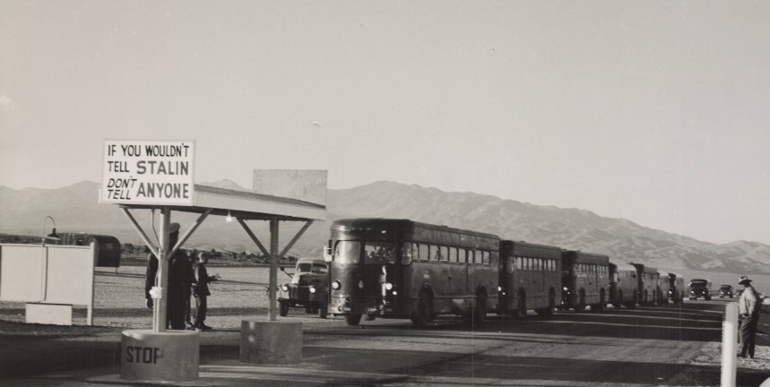
1949
Exit from Atomic Bomb Test Range
NAID 74238380

Slide 34
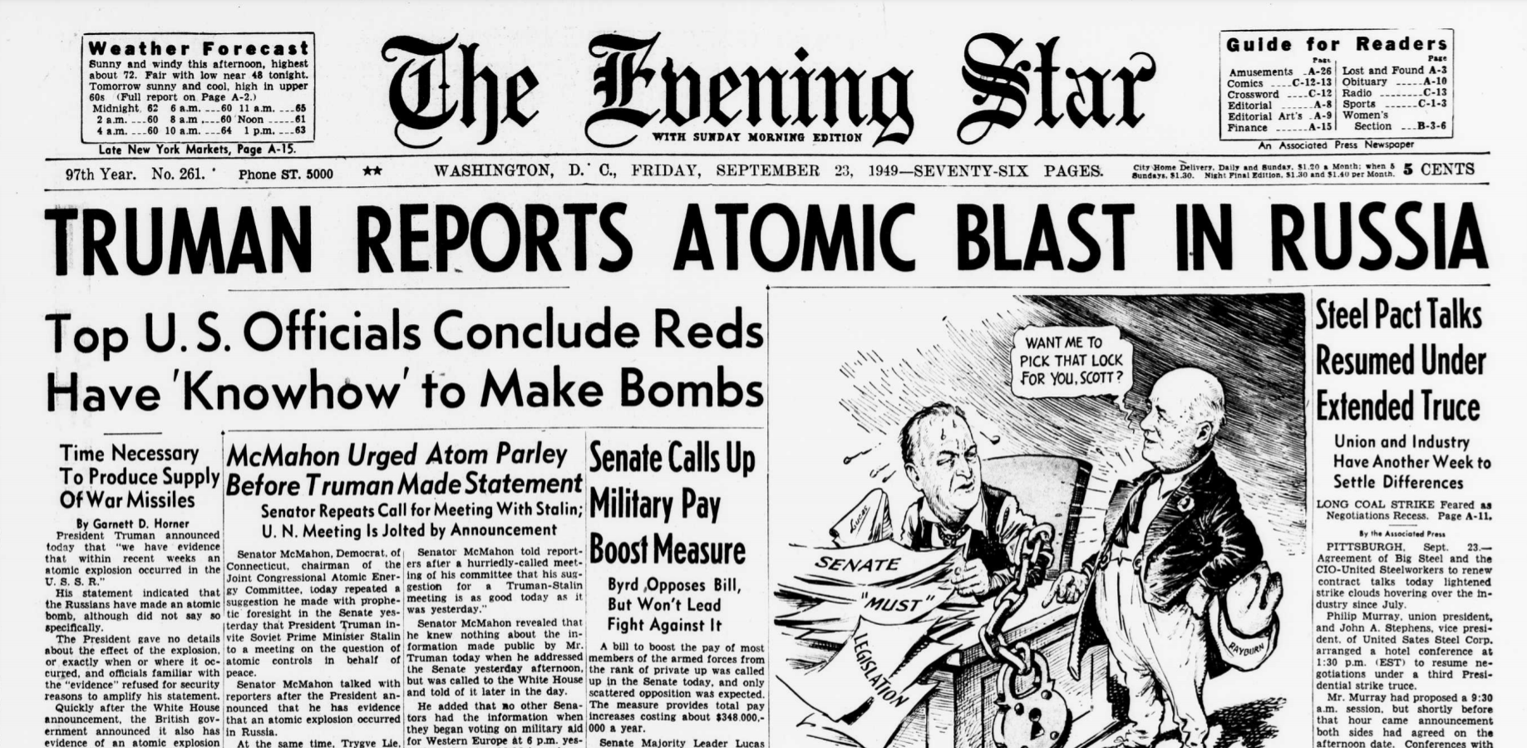
Soviet Union Explodes and Atomic Bomb, September 23, 1949

Slide 35
Conflict in Asia
The Chinese Revolution
1949
October 1, 1949, Chinese Communist leader Mao Zedong declares creation of the People’s Republic of China (PRC).
End of civil war between the Chinese Communist Party (CCP) and the Nationalist Party, or Kuomintang(KMT)
The Evening Star, Washington, DC
8/5/1949,
12/8/1949
Notes:
The Chinese Revolution of 1949
On October 1, 1949, Chinese Communist leader Mao Zedong declared the creation of the People’s Republic of China (PRC). The announcement ended the costly full-scale civil war between the Chinese Communist Party (CCP) and the Nationalist Party, or Kuomintang (KMT), which broke out immediately following World War II and had been preceded by on and off conflict between the two sides since the 1920’s.

Slide 36
Conflict in Asia
Two Chinas on the Brink of War
1949 - 1953
In 1949, China’s non-communist Nationalist Party, led by Chiang Kai-Shek, retreated to Taiwan
They plotted to return to power on the mainland
A U.S. naval fleet in the strait between Taiwan and the mainland prevented attacks from either side
The day before this cartoon was published, however, President Dwight D. Eisenhower removed the naval fleet
Chiang’s limited forces never posed any serious threat to communist China
“It’s All Yours,” The Evening Star February 3, 1953. Jim Berryman. NAID: 5743173
Notes:
It’s All Yours February 3, 1953 Jim Berryman NAID: 5743173 In 1949, China’s non-communist Nationalist Party was forced out of mainland China by the communist regime. The Nationalists, led by Chiang Kai-Shek, retreated to the island of Taiwan (also called Formosa). There they made plans to return to power on the mainland. The U.S. provided some equipment and kept a naval fleet in the strait between Taiwan and the mainland to prevent attacks from either side. The day before this cartoon was published, however, President Dwight D. Eisenhower removed the naval fleet. He seemed to be opening the way for Chiang to attack but did not provide additional support for the offensive. Chiang’s limited forces never posed any serious threat to communist China. Nevertheless, this incident added to the list of conflicts that complicated the relationship between the U.S. and communist China.

