Slide 1
The Roots of American Industrialization
Denver Brunsman George Washington University

Slide 2
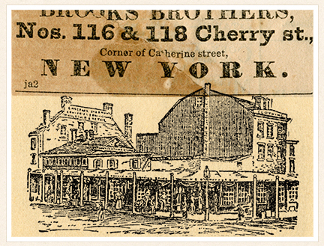
Early advertisement for Brooks Brothers, c. 1818

Slide 3
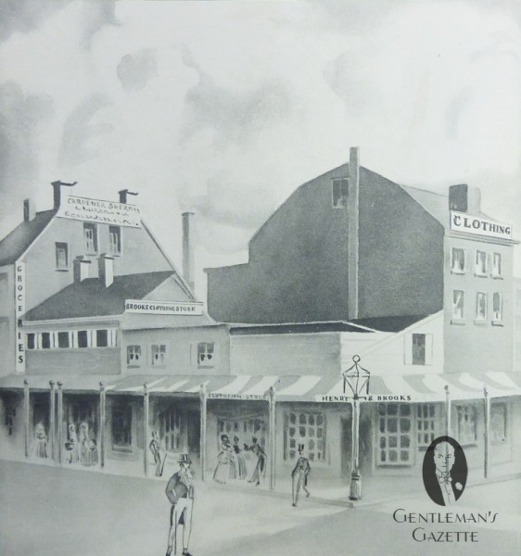
Brooks Brothers
in 1818

Slide 4
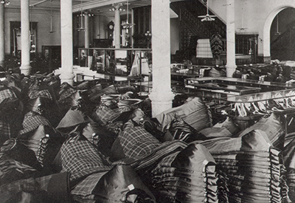
Inside of early Brooks Brothers store,
featuring ready-made clothing

Slide 5
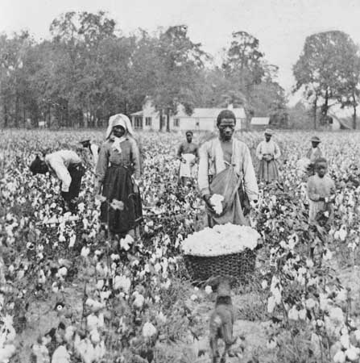
Georgia sharecroppers, c. 1898

Slide 6
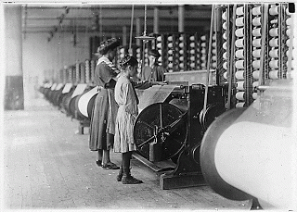
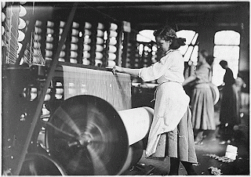
Lowell factory
women, production
of finished cloth

Slide 7
Inside of early Brooks Brothers store,
featuring ready-made clothing

Slide 8
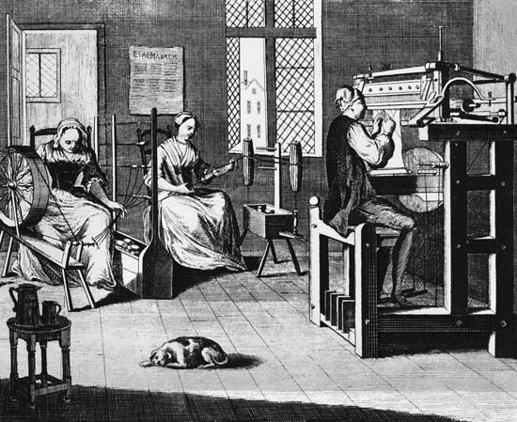
Putting-out system, precursor to full
industrial production

Slide 9
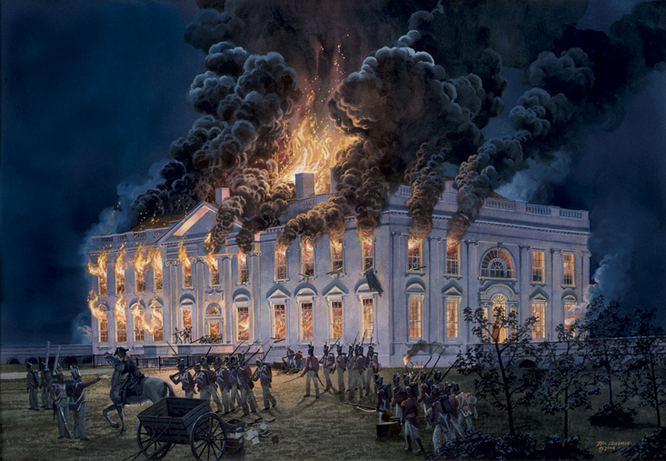
Burning of the White House, August 1814

Slide 10
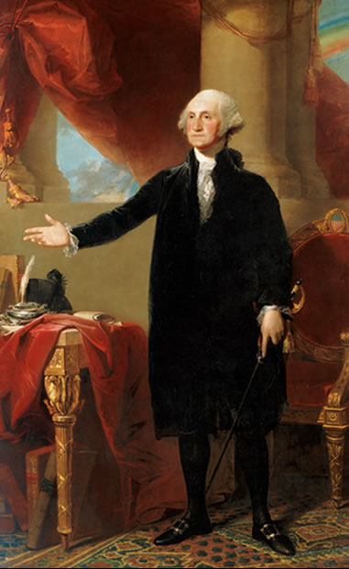
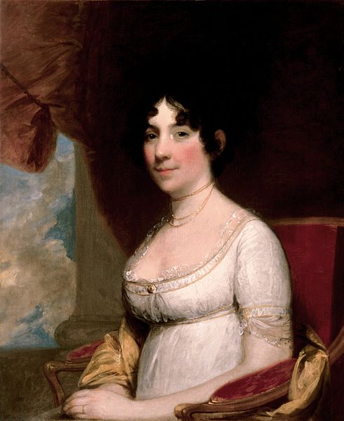
Dolley Madison helps to save portrait of Washington (August 24, 1814)

Slide 11
Democratic-Republican Economic Reforms
after the War of 1812
1. Charter of the Second Bank of the United States
2. Passage of protective tariffs
3. Appropriation for National Road ($100,000)

Slide 12
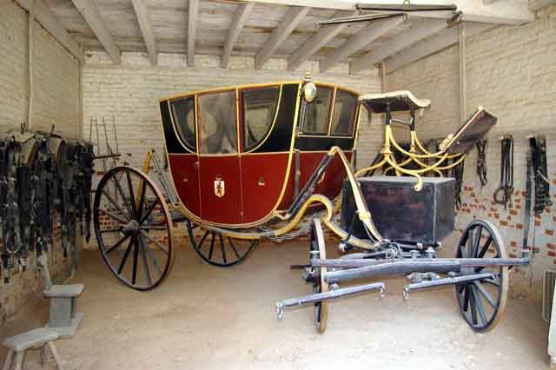
Horse-drawn coach, Mount Vernon, c. 1790s

Slide 13
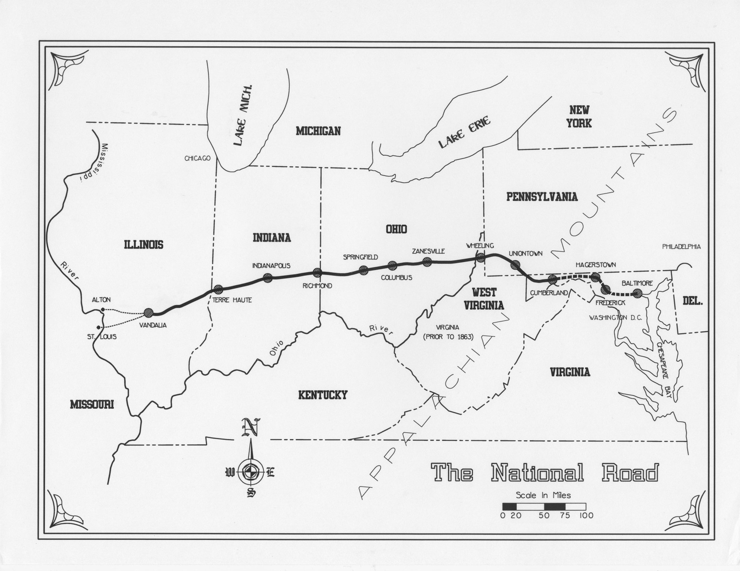

Slide 14
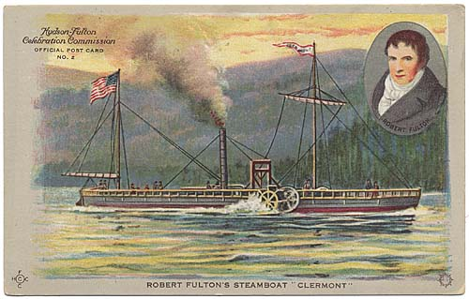
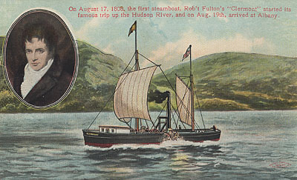
Postcards celebrating
Robert Fulton’s
invention of the
steamboat in 1807

Slide 15
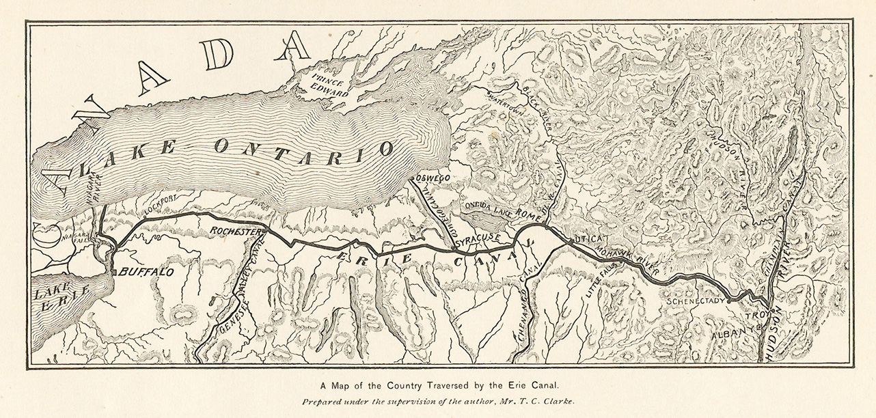

Slide 16
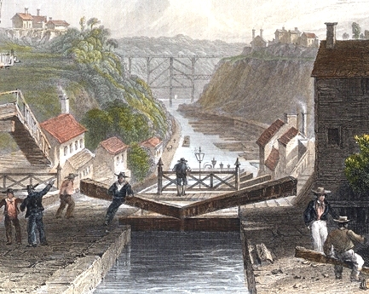
Erie Canal at Lockport, NY in 1839 by W.H. Bartlett

Slide 17
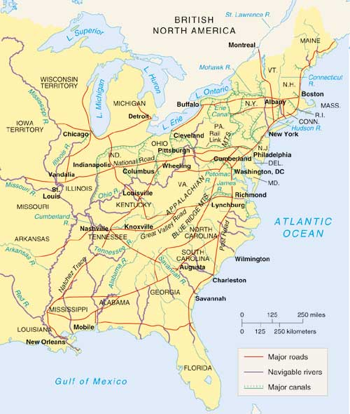
Transportation
Revolution
by 1840

Slide 18
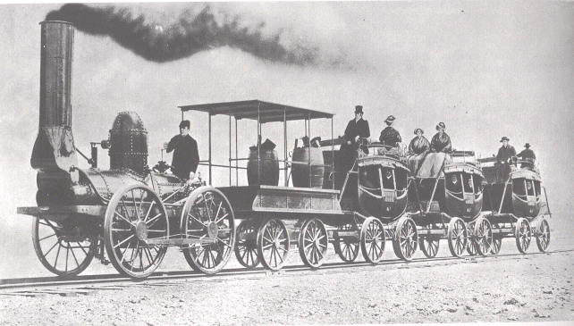
Early steam train, c. 1820s

Slide 19
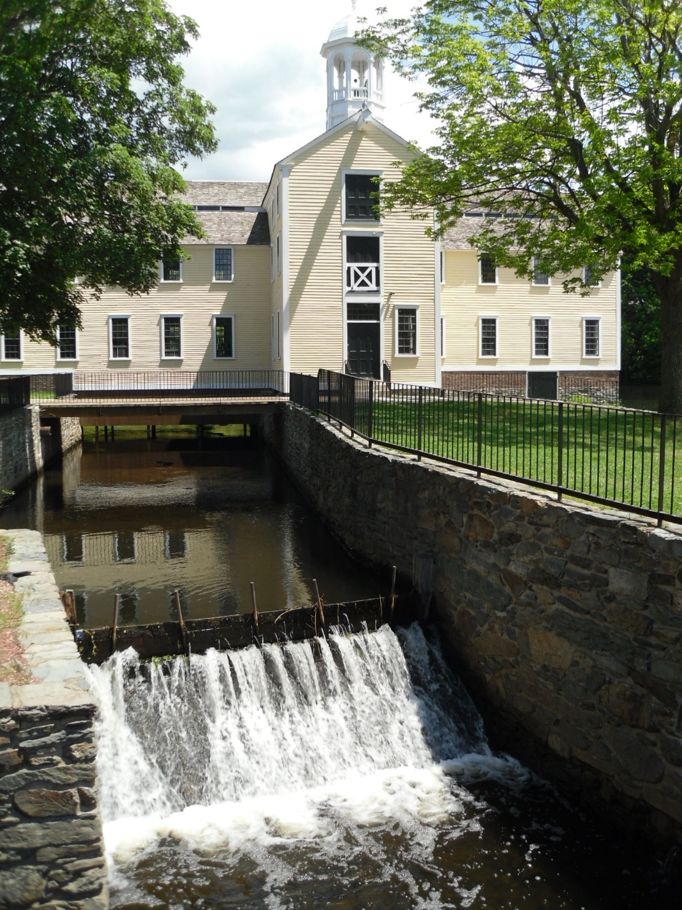
Samuel Slater’s
water-powered
spinning mill, R.I.

Slide 20
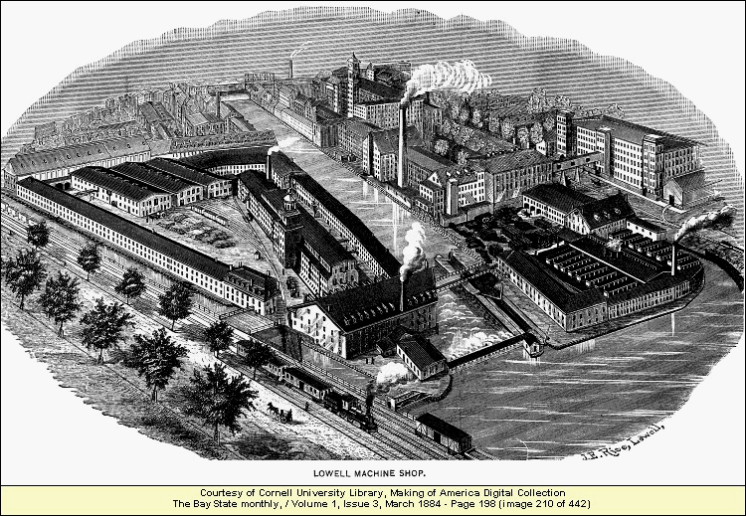
Lowell, Massachusetts, c. 1884

Slide 21
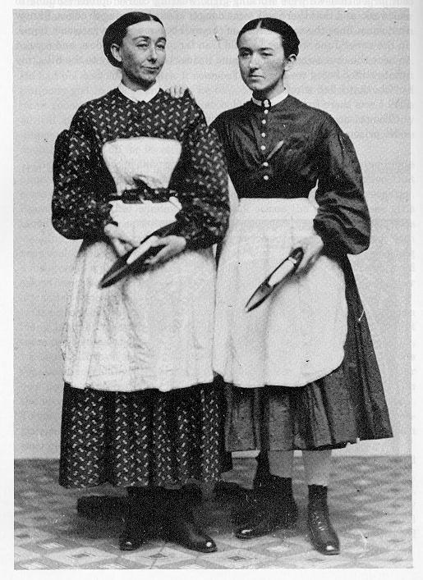
Lowell Mill “girls,”
c. 1860

Slide 22
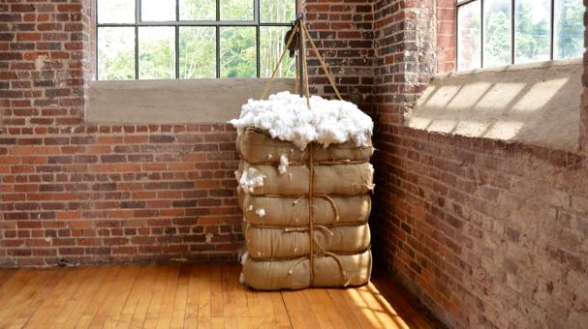
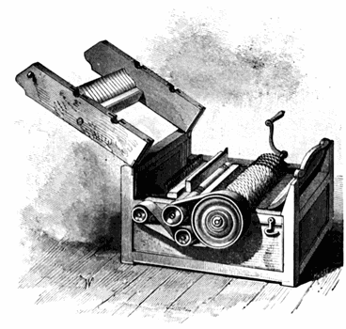
Eli Whitney's
cotton gin
Historic Bale of Cotton
(Greensboro Daily Photo)

Slide 23
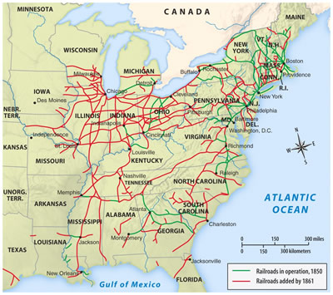
Spread of railroads by 1861 (two-thirds in North)

Slide 24
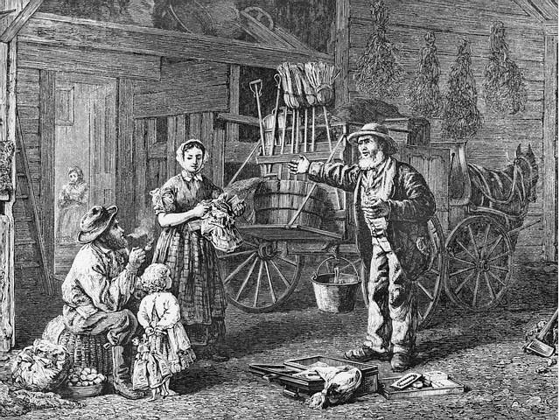
Yankee peddler, c. 1850

Slide 25
thank you!

